Slide 1

NAPTA TSC WEBINAR
November 14, 2023

Slide 2
Troubleshooting Skills Competition
A competition that showcases the problem-solving (troubleshooting) skills of PTEC students
from across the nation.

Slide 3
Troubleshooting Skills Competition
The 2024 NAPTA Troubleshooting Skills Competition (TSC) is a two-round competition:
  Qualifying Round (Virtual from your home campus)
  Championship Round (In-person)

Slide 4
NAPTA TSC
Qualifying Round

Slide 5
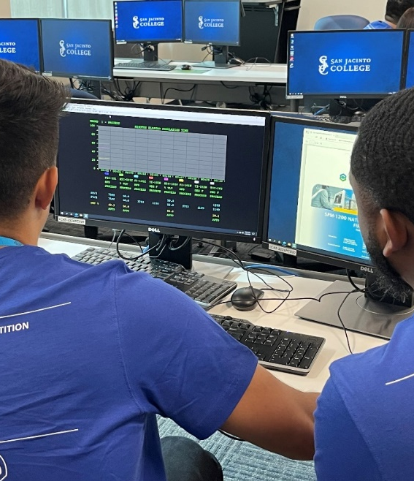
Qualifying Round
Unlimited number of colleges may participate
Unlimited number of teams from each registered college can participate
Teams will consist of three (3) members
Alternates must be designated. You may assign one (1) alternate per team or, assign a pool of alternates.
The number of alternates cannot exceed the number of registered teams in the QR.
Twelve (12) highest-scoring teams may advance
to the Championship Competition as finalists
Maximum of two (2) teams from any same college campus may advance to the Championship Competition
Finalist teams must travel to the host school to compete

Slide 6
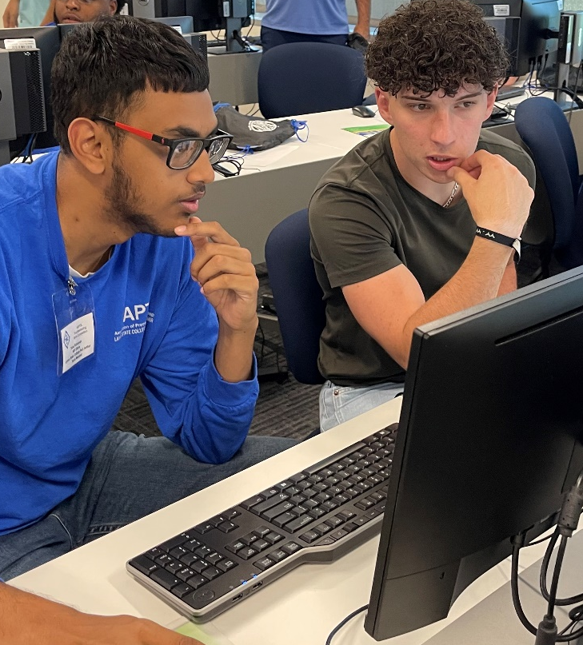
Qualifying Round Format
Teams will compete using a web-based system from the college’s home campus:
  Three (3) timed scenarios in the QR
  Teams will compete at a time and date chosen by their coach
  Teams will compete during the time frame of March 6th through March 31st

Slide 7

Qualifying Round Process
Secure QR location
Ensure the computer has internet access
Assign Proctor
Lock in your QR date and time
Confirm accessibility (practice login)
Teams log into the website

Slide 8
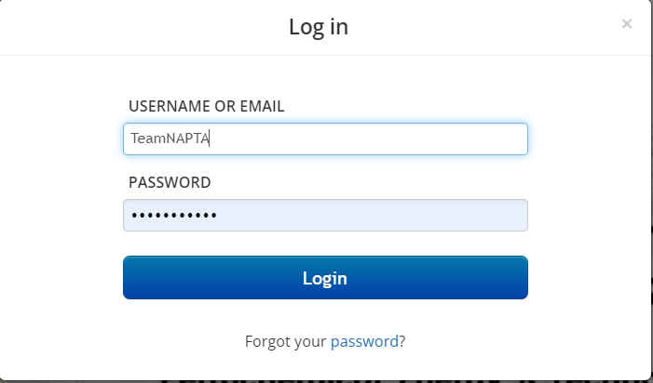
Qualifying Round Process

Slide 9
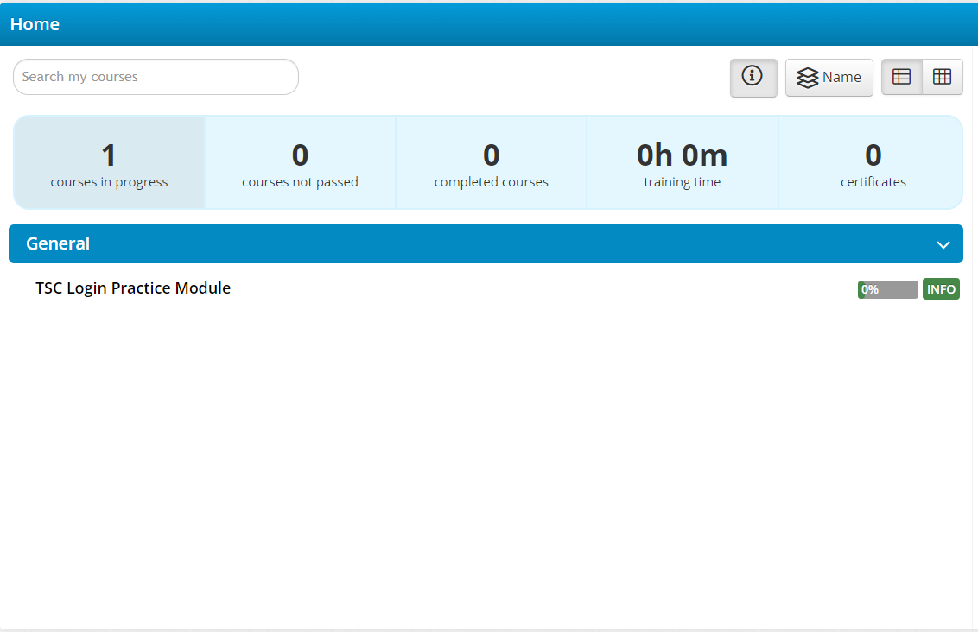
Qualifying Round Process

Slide 10
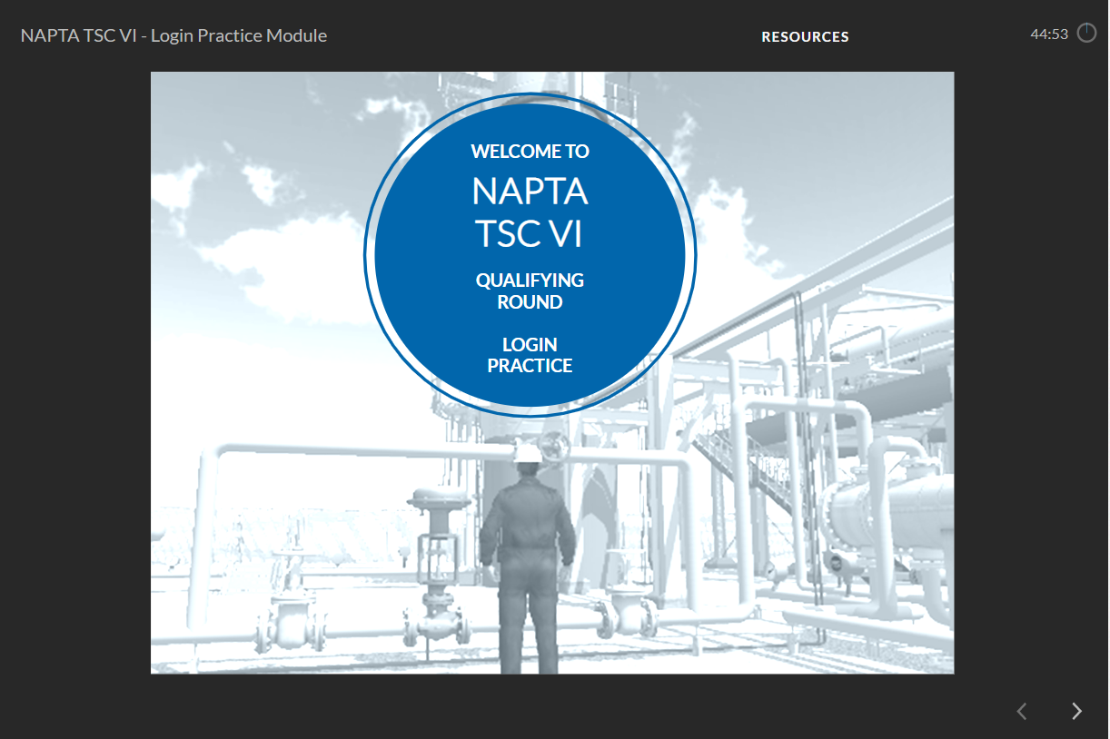
Qualifying Round Process

Slide 11
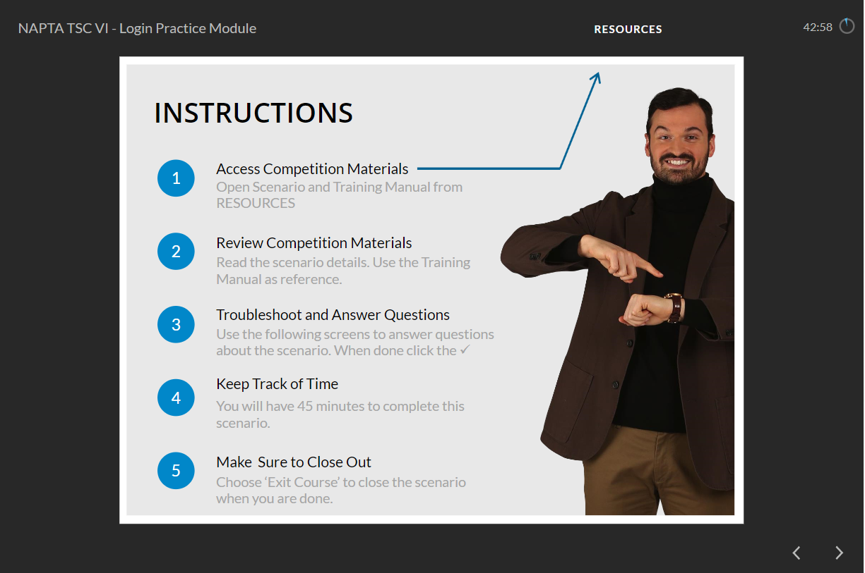
Qualifying Round Process

Slide 12
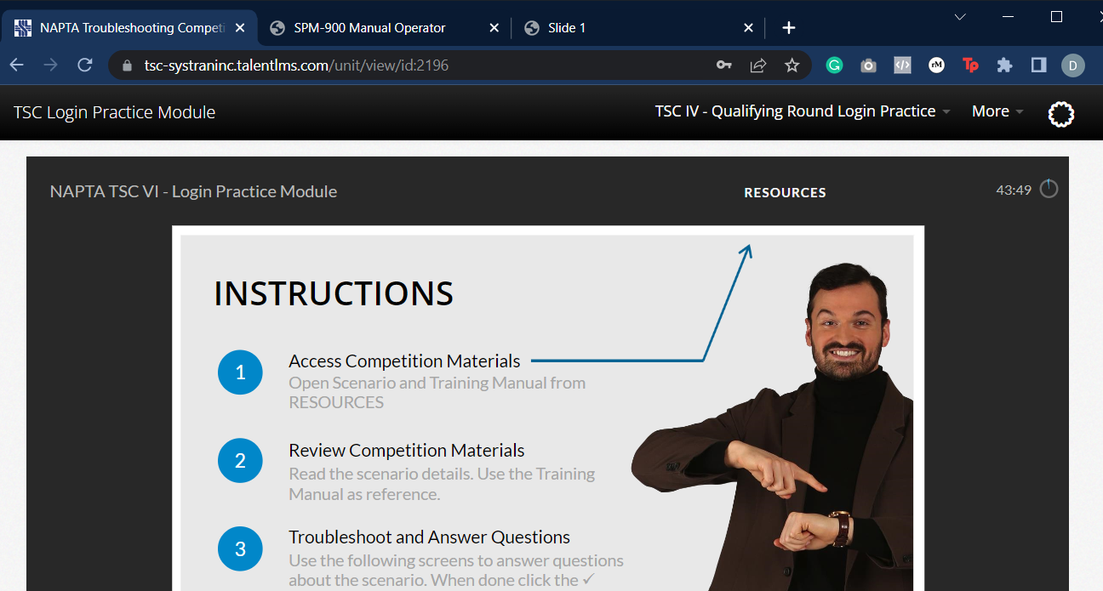
Qualifying Round Process

Slide 13
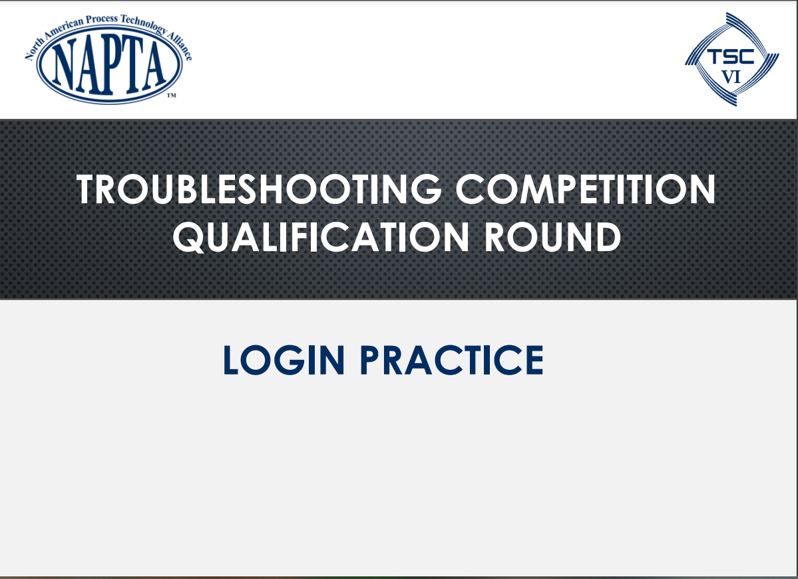
Qualifying Round Process

Slide 14

Qualifying Round Process

Slide 15
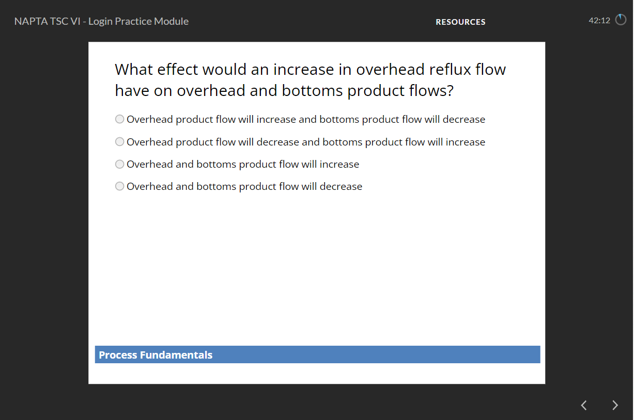
Qualifying Round Process

Slide 16
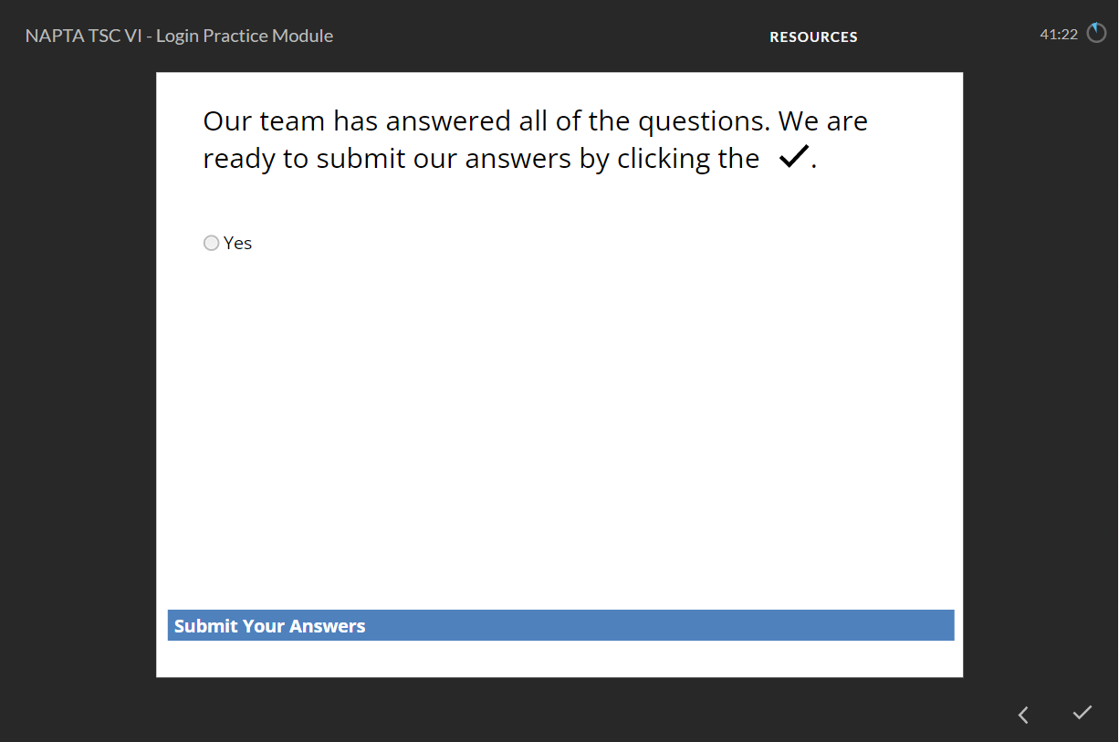
Qualifying Round Process

Slide 17
Qualifying Round Process

Slide 18
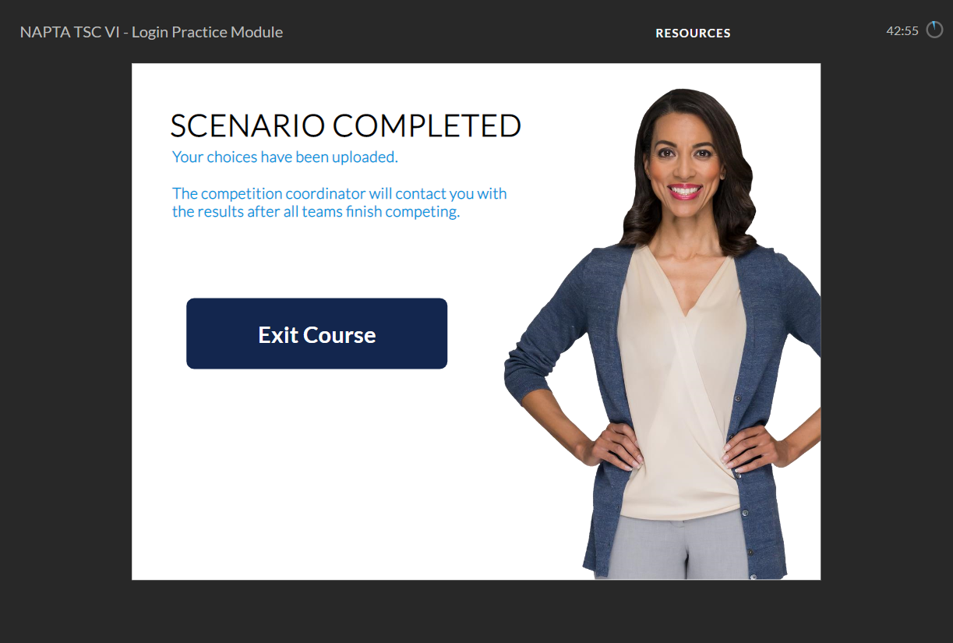
Qualifying Round Process

Slide 19
Qualifying Round Process
Select Your Teams
Practice, Practice, Practice
Register Team Name(s) & Team Member Names
Select your Qualifying Round Date
Compete in the Qualifying Round
Results Announced
Practice, Practice, Practice
Travel to
College of the Mainland
TSC Championship
Competition

Slide 20
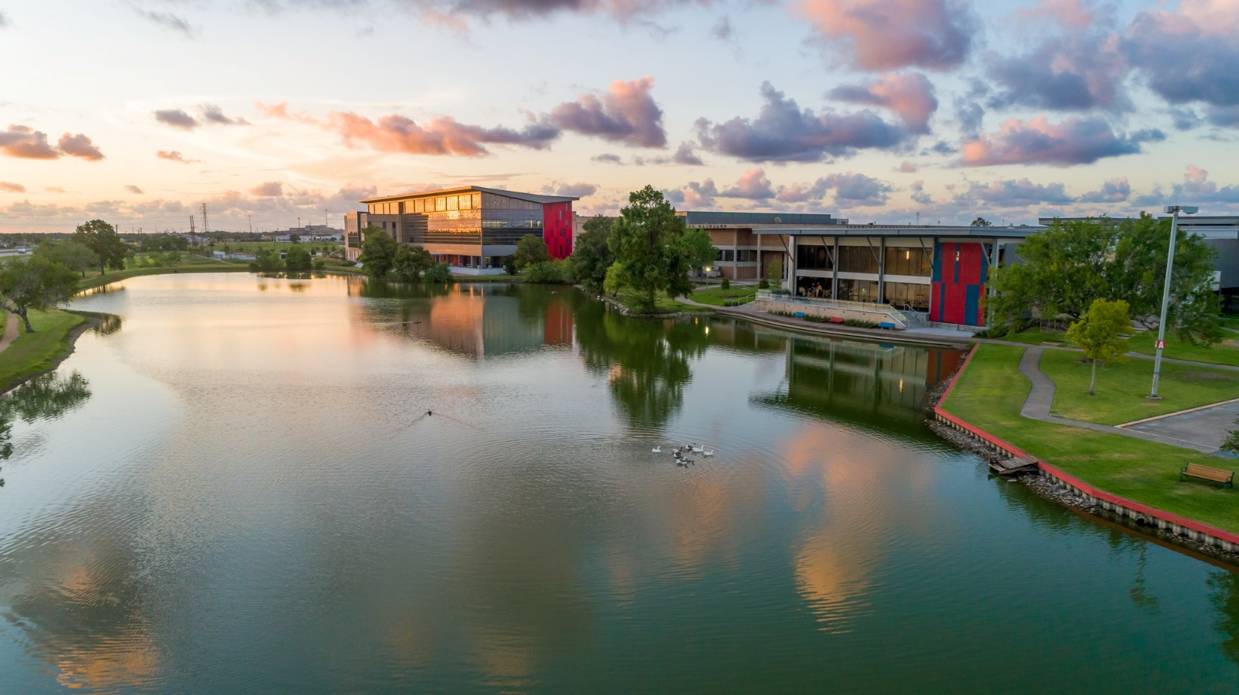
TSC Championship Competition Location
College of the Mainland
Texas City, Texas

Slide 21
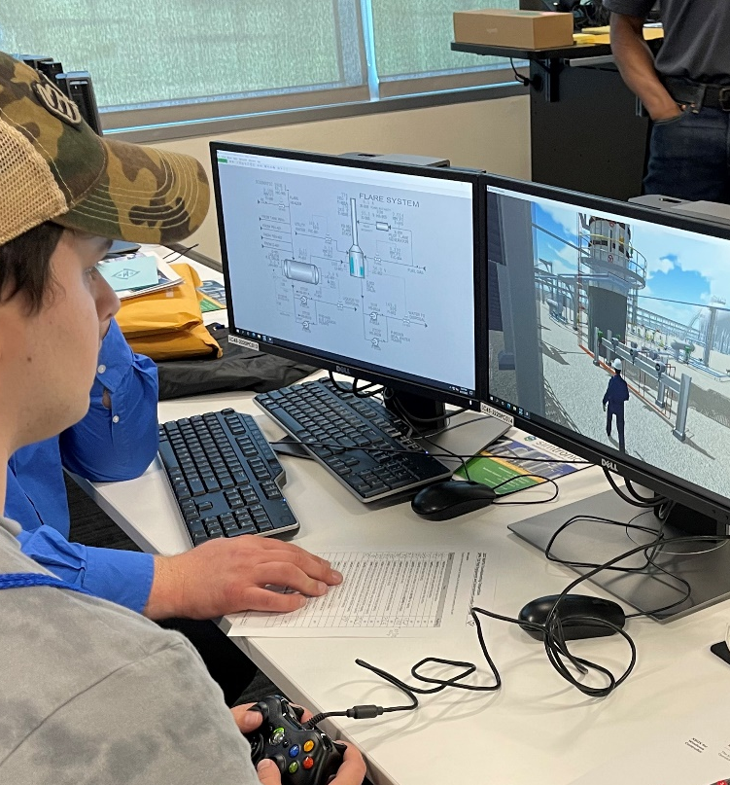
TSC Championship Competition Location
Twelve teams participate
All team members participate in industry related activities on Thursday, April 18th
All teams compete in live simulation-based exercises on Friday, April 19th
Four timed rounds. Cumulative scores from all rounds determine the 1st – 12th place teams
Awards ceremony (1st through 3rd place) for highest scoring teams at Awards Banquet held Saturday evening

Slide 22

Questions

