Slide 1

WELCOME TO LAKE CHARLES!!
NAPTA Winter General Meeting 2020
  Friday, February 21, 2020
  Isle of Capri Conference Center
  Lake Charles, LA

Slide 2
Welcome to the NAPTA General Meeting
Greetings from the NAPTA
Board Chair
David Esquibel
Safety Moment
“caring by sharing”

Slide 3
Presentation of NAPTA Board
2020 Board of Director Members Are:
David Esquibel – Chair/Chief Executive Officer
David King – Vice-Chair
Glenn Johnson – Treasurer/Chief Financial Officer
Eric Newby – President/Executive Director
Steve Backman – Secretary
Madonna Adams – Director
Sallie Kay Janes – Director
Scott Krejci – Director

Slide 4
Participant Introductions
Executive Director – Eric Newby
Name (nickname, if you dare…) and Title
Employer – Who you’re here representing
Job/Duties – What you do for who you’re with
PTEC Involvement – How you contribute - Advisory or NAPTA committee(s) or other
PLEASE BE BRIEF…

Slide 5

NAPTA
Learning
Materials
Update
Winter Meeting
February 21, 2020

Slide 6



Available Second Edition NAPTA Titles
Introduction to Process Technology, 2e
Process Technology Equipment, 2e
Safety, Health and Equipment, 2e

Slide 7

NAPTA Titles Coming Soon - March 2020
Process Instrumentation, 2e

Slide 8

What’s New in Process Instrumentation, 2e?
Content reorganization to enhance learning: (Part 1) Intro and Process Variables; (Part 2) Symbology, Hardware, and Instrumentation Communication; (Part 3) Control Loops, Controllers, Control Schemes, Digital Control and PLC; (Part 4) DCS, Power Supply, ESD, Malfunctions, and Troubleshooting.
Learning Outcome alignment with NAPTA core objectives, with links provided from objective to text page.
New series design and features
New! Comprehensive art program including more than 350 full-color images.
• New content on intrinsically safe display devices/tablets, wireless
technologies, and intranet protocol transmission/ addressing.
Expanded coverage of PT roles related to cybersecurity, industry
4.0, and analytic data trends.
• NEW Instructor Resource Package

Slide 9
Image by Nathalie Lees
Instructor
Resource
Package
Reminder
Instructor resource | Description
Lesson plans | For each chapter: Suggested teaching time to reach objectives Any particular prep needed Suggested classroom and lab activities Set of unique MC review questions similar to but unique from EOC questions
PPT slides | Chapter by chapter and associated with lessons in lesson plans
Review questions | End of lessons (and/or chapter) review questions
Test bank | 3-5 multiple choice questions per chapter objective, tagged to learning objectives. Include correct answer and rationales for all answers.

Slide 10

MyLab with Pearson eText
Available for the following:
Introduction to Process Technology, 2e
Process Technology Equipment, 2e
Safety, Health, and Environment, 2e
Includes:
Key Term Review (interactive)
Chapter Review Quiz Questions
Equipment and Process Review (interactive)
Short Answer Questions
Pearson eText

Slide 11

MyLab with Pearson eText
Coming Soon for
Process Instrumentation 2e
Anticipate fully live by end of July 2020
Same format as Introduction; Equipment; and Safety, Health, and Environment texts

Slide 12


NAPTA Titles in Development for 2nd Editions
Process Quality, 2e
Coming Early 2021
Process Operations, 2e
Coming Summer 2021
New Edition
in Production
New Edition
in Production

Slide 13
NAPTA Titles in Development for 1st Editions
Process Systems
Coming
2021
Process Troubleshooting
Coming
2022

Slide 14
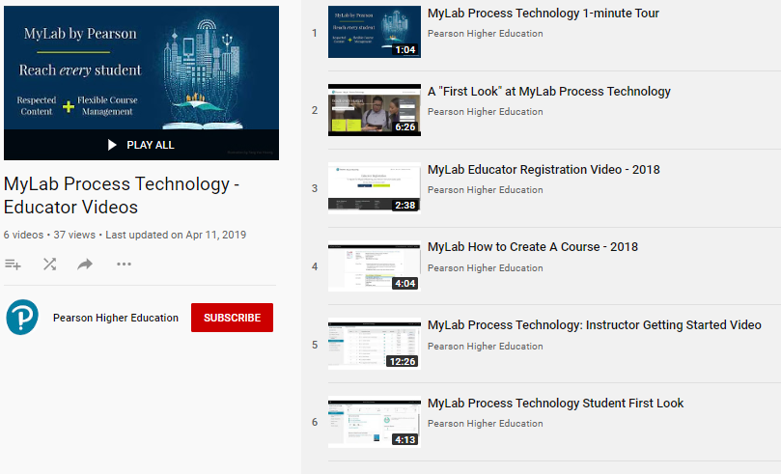

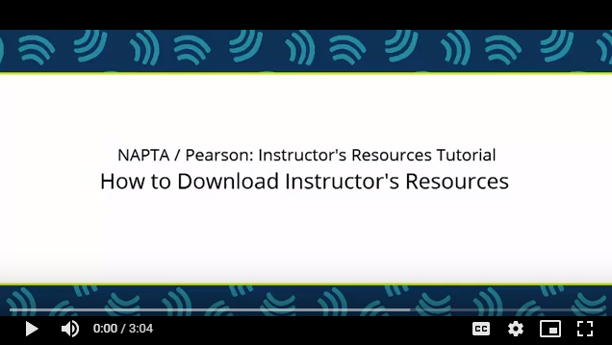

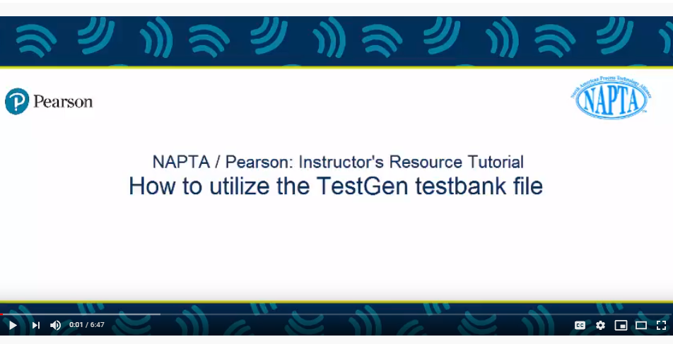
Additional Resources
MyLab
Process
Technology
Educator
Videos
MyLab
Process
Technology
Student
User’s
Guide
MyLab
Process
Technology
Instructor
Implementation
Guide
Process Technology
Instructor Resources & TestGen Videos

Slide 15
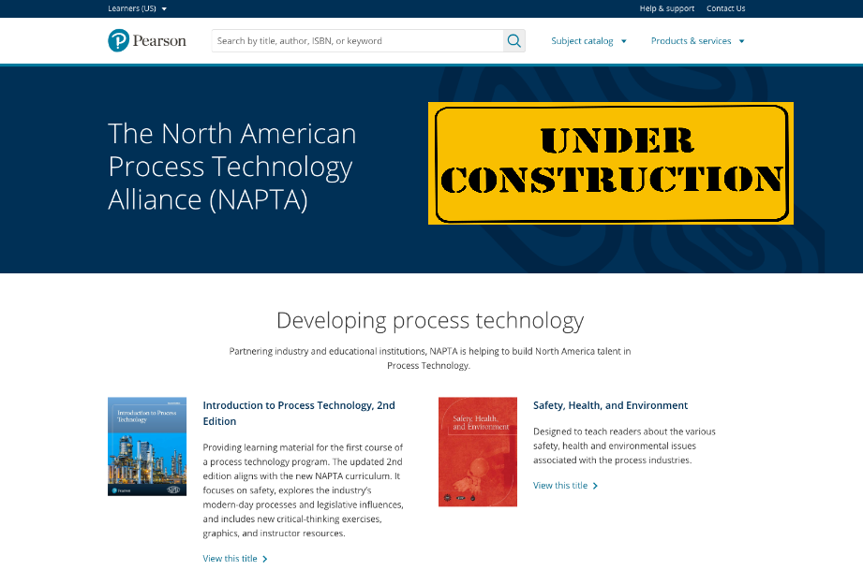

Slide 16
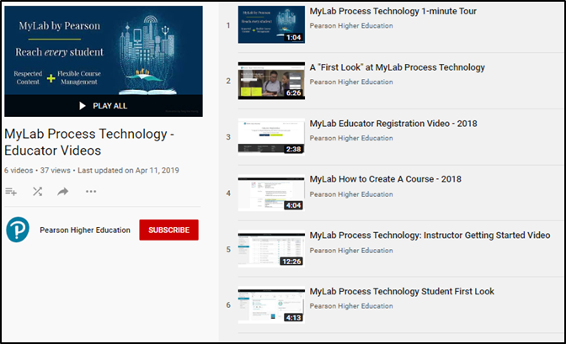
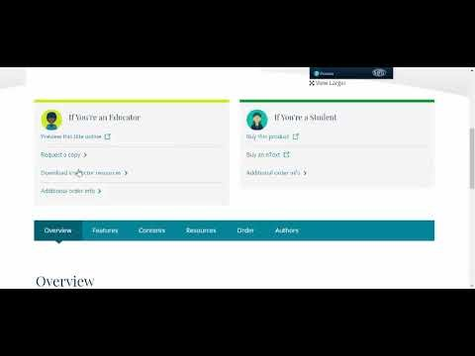
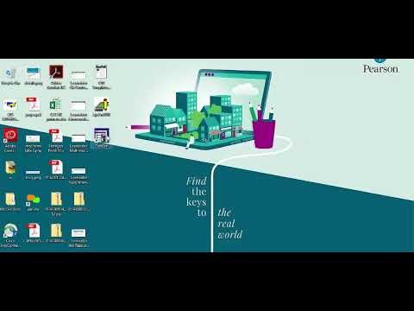
Process Technology Videos
MyLab Playlist for Educators
Instructor Resource Videos for Educators
MyLab Process Technology - Educator Videos
Pearson NAPTA Educator Tutorial: How to access Instructor's Resources
Pearson NAPTA Educator Tutorial: How to Utilize TestGen

Slide 23
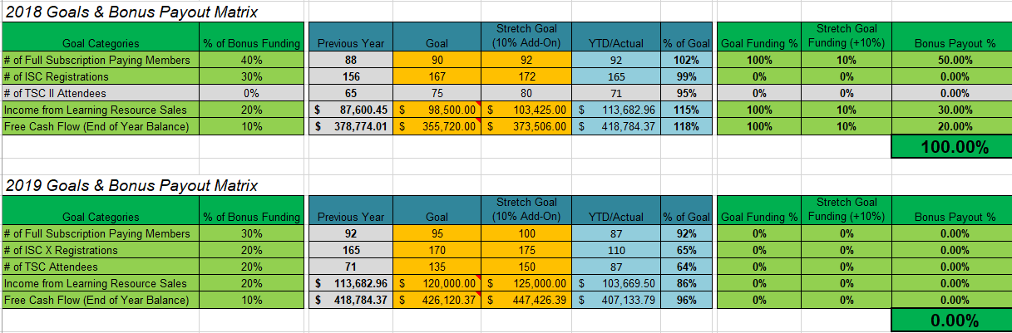

Slide 25
“NEW” Members
Steve Backman – NAPTA Secretary
Presentation of new members
  Bishop State Community College
  Festo Didactic Inc
  Simplant Training
  Alief Center for Advanced Careers (CTE Campus)
  Central High School – Pollok, TX

Slide 26
NAPTA Troubleshooting Competition
Let’s Get Ready to Troubleshoot!

Slide 27
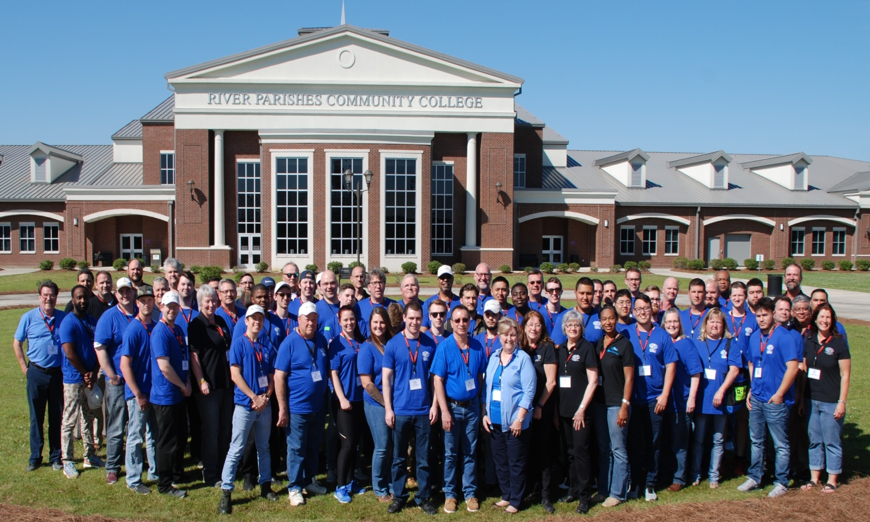
THE 2019 FIELD OF COMPETITORS & COACHES

Slide 28
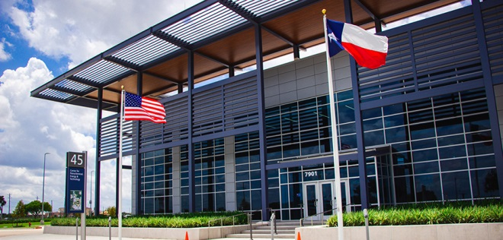
LyondellBasell CPET Center
New Petrochemical Training Facility!
Site of TSC IV

Slide 29
We Need Your Teams!
Great Student Opportunity
Exposed to “Real-Time” Scenarios
Networking with Industry Representatives
Gain Troubleshooting Experience
Builds Confidence in Process Operations

Slide 30
TSC 2020 Format
No Qualifying Round
Maximum Two Teams from Each College
All Participate in the Open Round
Activities for Non-Competing Teams, both
Friday and Saturday
Ten Finalist Teams Compete on Saturday

Slide 31
Registration Update
Registration Closes March 13, 2020
Eligibility = Two Four-person Teams from Your College
Student Benefits | College Benefits
Resume’ Booster Additional hands on experience Interaction with industry reps Realistic and fun experience | College PTEC Program Recognition Recruiting/marketing tool for future enrollment Preparing students for success Rewarding experience for coaches

Slide 32
Sponsorship
Sponsorship opportunities for our industry and vendor members are still available.
Please see Eric or Martha after the meeting.

Slide 33
Contacts
Martha McKinley
troubleshooting@naptaonline.org
903.452.8511
Kay Sanchez
administrator@naptaonline.org
Eric Newby
director@naptaonline.org

Slide 34

Questions

Slide 35
NETWORKING BREAK
Fifteen (15) minutes
Make a new acquaintance!
Be back ON TIME!
Thanks!

Slide 36
PTEC Best Practices
“Leveraging”
Internships

Slide 37
Introductions
Mike Lopez
Indorama Ventures
Manufacturing Excellence Coordinator
  Contact information:
  Mike.Lopez@us.Indorama.net
  office number (409) 723-3445

Slide 38
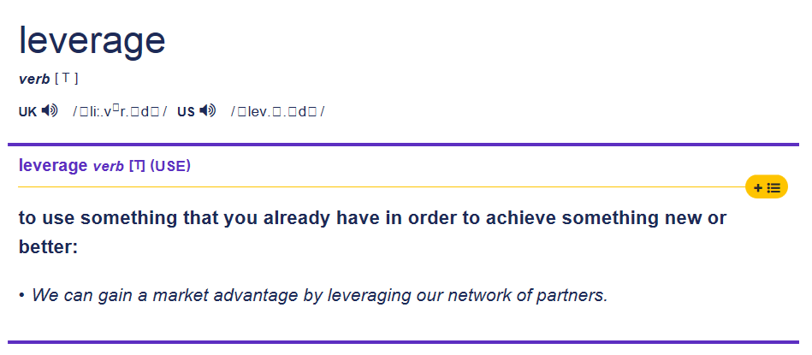
Definition

Slide 39
Why have a co-op program?
Contribute to the education of process technology students
Extended evaluation for job openings
Evaluation of PTECH programs
Partnering with local colleges

Slide 40
Recruiting
Job fairs
Mock interviews
Site tours
Proctor troubleshooting competition
Posting

Slide 41
Selection
Resumes
Testing
Interview
  Behavioral based questions
  Technical questions

Slide 42
Things to consider
Do we utilize pre-employment testing?
Do we consider GPA?
Do we consider the number of classes a student has remaining?
How much emphasis do we put on industrial experience?
Do we accept recommendations from faculty?

Slide 43
Applicant Requirements
Indorama Ventures - Port Neches requirements
  NAPTA endorsed program or equivalent
  GPA of 3.0 or better
  Last semester prior to graduation
  Enrolled in co-op class
  Maximum of 2 classes in addition to co-op
  Must be eligible for a TWIC card
Some requirements may be listed as preferred

Slide 44
Program
Short or long semesters
  Summer, Spring or Fall
Number of co-ops
Mentor selection
Structured to allow for successful completion of degree plan
  Students allowed to miss work for class
  Schedule work day around class schedule

Slide 45
Timeline
Program starts 1-2 weeks before beginning of semester
17-week program during Spring and Fall semesters
  2 weeks of New Employee Orientation
    8-hour work-days Monday thru Friday
  4-week assignment in utilities, loading and process areas (total of 12 weeks)
    12 hour rotating shifts
  1 week of evaluation and training between area assignments (total of 3 weeks)
    8-hour work days Monday thru Friday

Slide 46
Feedback
Reports written during week of evaluation
  Overview of experience
  Improvements to training material
  Material covered not part of program curriculum
Presentation by co-ops reviewing experience given to site staff and college faculty at end of program
Co-op feedback shared with program coordinators

Slide 47
Successes
Co-op program acceptance by union
Mentors
  Mentors have given a positive image of company
  Mentors complete an evaluation used by coordinator to assess and coach co-ops
Co-ops serving as mentors
Feedback is improving process technology programs

Slide 48

Questions?

Slide 49
2020 NAPTA Endorsement
Presentation of 2020 NAPTA Endorsement Certificates
Dorothy Ortego/Sasol US – Industry Co-chair
Linda LaCoe/Lone Star College – Education Co-chair

Slide 50
Endorsement Committee Report
Dorothy Ortego/Sasol US – Industry Co-chair
Linda LaCoe/Lone Star College – Education Co-chair

Slide 51



NAPTA PPT Template
“Making a Difference through Instructional Excellence”
Instructor Skills Conference XI Update
NAPTA Winter Meeting
February 21, 2020
Curtis Briggs
Dennis Link

Slide 52
Active ISC XI Committee Members
      Curtis Briggs – Industry Co-Chair
      Dennis Link – Education Co-Chair
      Eric Newby – NAPTA
      Kay Sanchez – NAPTA
      Susan Davis – NAPTA
      Steve Ames
      Steve Backman
      Tim Judge
      Mike Kukuk
      Jeff Laube
      Dawana Medina
      Vicki Newby

Slide 53
Conference Enhancements
      Two Networking Hospitalities
      Networking Treasure Hunt
      Bringing Back Discussion Groups and Panel Discussions
      Participant-Decided Discussion Groups Activity
      Topic of the Day Sharing Opportunity
      Increased Emphasis on Lifetime Achievement Award Presentation
      Mixing Up General Session Seating to Promote Networking

Slide 54
Keynote Speaker Preview
      Gallery Furniture owner Jim “Mattress Mack” McIngvale “Making a Difference in the Lives of Others”
      Franklin Covey’s Darin Hoggan “Leading in the Classroom” Seven Habits of Highly Effective Instructors/Trainers
      LIT Technical Chair Tiffany Parker “PTEC Success Story”

Slide 55
Learning Session Preview
      Basic Instructor Fundamentals (Certificate Track)
      Creating Valid Test Questions
      Utilizing DISC Personality Assessment to Enhance Learning
      Accelerated Learning
      Utilizing Digital Technology
      Championing Diversity
      New Hire Job Qualification Process
      Simulator Best Practices
      Process Technology Internship Best Practice

Slide 56
NAPTA Member Action Plan
  Share highlights of ISC XI with:
      College Instructors
      Industry Training Personnel
      Process Technology Advisory Committee Members
  Utilize the following Communication tools to share ISC XI updates:
      LinkedIn
      Facebook
      Twitter
      College email
      Company email
      Face-to-Face Communication

Slide 57
NAPTA PPT Template
“Making a Difference through Instructional Excellence”
An average instructor tells, a good one explains, an excellent one demonstrates and a best in class instructor makes a positive difference in the lives of others by inspiring them to be the best they can be.

Slide 58
NAPTA Outreach Committee Update
Tammy Netherland – Systran
Joseph Zweircan – San Jacinto College
Social Media Strategy 2020

Slide 59
Roundtable Ramblings
“Challenges of Today’s Learners”
What “challenges” do YOU face in the classroom or training room today?
What “solutions” have you developed to deal with them?
Write them down and be ready to share…

Slide 60
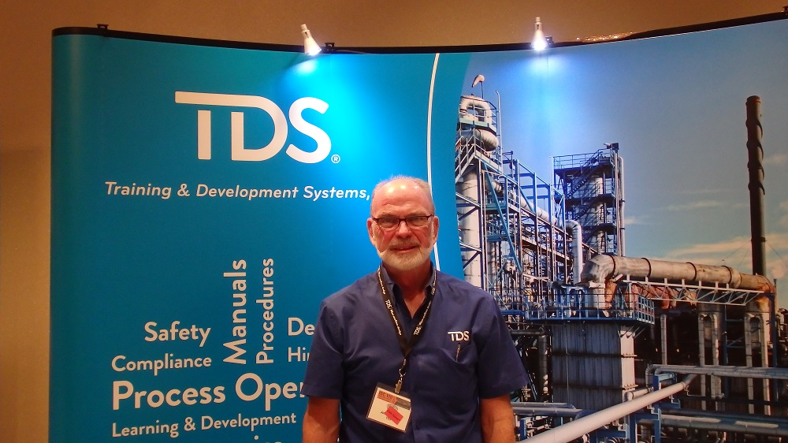
NAPTA Appreciation for Dedication
John Wilson 1952 - 2020

Slide 61
On-Going and New Business
PTEX-CR Incorporation into Endorsement
  Eric Newby
  Dorothy Ortego
Lifetime Achievement Award Nomination/Selection Process Development
  Mike Kukuk

Slide 62
On-Going and New Business
Anything Else to Offer?
Any Questions?
Any Upcoming Events?
  For inclusion on the NAPTA calendar
  That NAPTA should attend

Slide 63
LUNCH!!!
Don’t forget to take advantage of networking opportunities…
Eat responsibly….:o)

Slide 64

Safe Travel and See ya’ Soon!

