Slide 1

UNLEASH the Future
Crystal Lannaman
BASF
NAPTA Petrochemical Competition Operator Troubleshooting Competition
April 23, 2021

Slide 2
UNLEASH
Release from a lease or restraint
Let out creative energy
Let it flow
Relish the possibilities
Doing something today that your future self will thank you for later

Slide 3

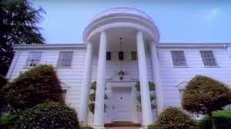
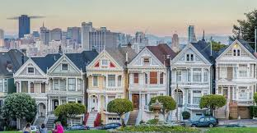

Slide 4
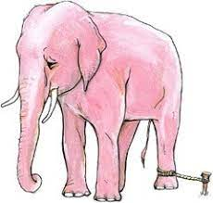
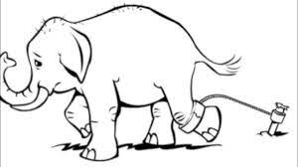
Assumed Constraints

Slide 5
7 Pointers for UNLEASHING Your Future
Know your strengths
Everyday make a small step
Relationships & Knowledge (there is a balance)
Manage your energy
Celebrate small wins
Never stop growing
Laugh

Slide 6
