Slide 1

NAPTA TSC Committee
2021 Visions Meeting Report
Martha McKinley NAPTA General Meeting 2021

Slide 2

TSC Committee Breakout Session
Develop Vision & Mission Statements
Develop Objectives that Align with the Committee’s Vision and Mission
Reviewed Committee Membership
Discussed Committee Co-Chair Position
Martha McKinley NAPTA General Meeting 2021

Slide 3
TSC Breakout, Cont’d
Develop Team Report Template
Discussed Simulation Software Provider – TABLED
Format Changes – Open Discussion
  Face-to-face event
  Conduct a dry run practice session
  Concern expressed about maximum team registration
  Simulation software should be the same for both Qualifying & Finals Rounds
  More active sponsors
  Allow company interviews
  Communication transparency
  Create a learner journal
Martha McKinley NAPTA General Meeting 2021

Slide 4
NAPTA Troubleshooting Competition
2021 Reflections
Martha McKinley NAPTA General Meeting 2021

Slide 5

Format Change
Conducted Online Via Conference Venue
COVID Restrictions Dictated Format
Decision Made to Switch to Online Venue
Production Companies Researched
The Production Companies (TPC) Selected
Production Completed With Help of TSC
Standing Committee, TPC Staff, & NAPTA Staff
Martha McKinley NAPTA General Meeting 2021

Slide 6
TPC PRODUCTION
VIA
HOPIN PLATFORM
https://hopin.com/events/napta-troubleshooting-skills-competition-iv-2021-14330e61-7d0f-4d1f-9c43-e72ed2c5ba87?code=Lf3L6DTi32PxyT5nE2rMbSIrS
Martha McKinley NAPTA General Meeting 2021

Slide 7
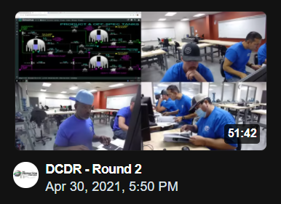
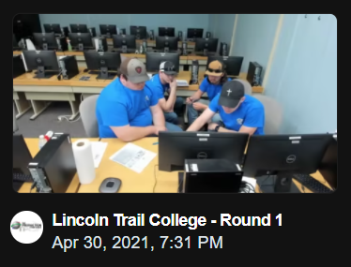
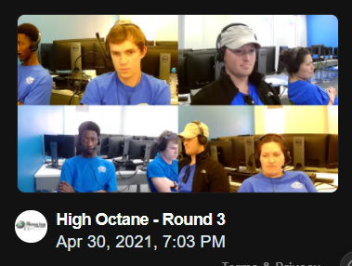
Teams at Work

Slide 8
The Structure
Practice Round held on home campus – Conducted by PetroSkills/Simulation Solutions
All teams advanced to the Final Round
Teams consisted of 4 persons – Captain and 3 members
Alternates were substituted on some teams
Teams without alternates competed with 3 team members
Martha McKinley NAPTA General Meeting 2021

Slide 9
REGISTERED
15 Teams from Ten Colleges
2 Teams from Ecuador (exhibition)
Martha McKinley NAPTA General Meeting 2021

Slide 10
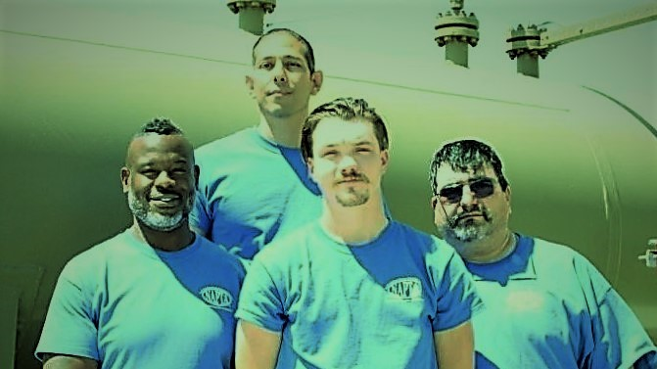
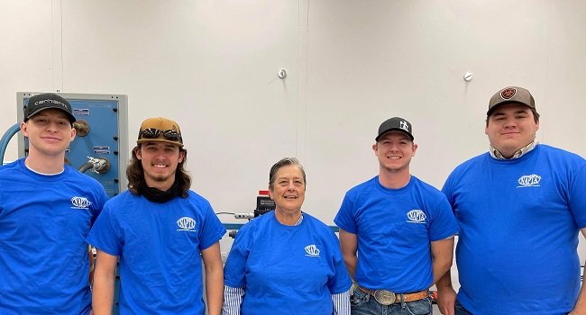
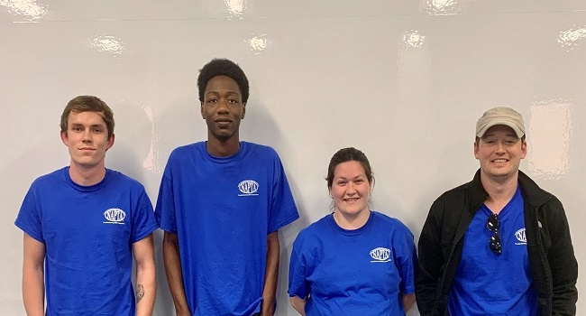
2021 Top Three Finishers
DCDR
Victoria College
Lincoln Trail College
Lincoln Trail College
High Octane
Lamar Institute of Technology

Slide 11

TSC 2022 Information
(Tentative)
Location – San Jacinto College CPET Center
Date – April 21 – 23, 2022
Registration Opening – November 1, 2021
Registration Deadline – TBD
Martha McKinley NAPTA General Meeting 2021

Slide 12

Questions

