Slide 1
Thanks for Joining Us!
The NAPTA 2021 Summer General Meeting will start in a few minutes!
The Audio, Video, Participants, and Chat buttons are across the bottom of your screen and will appear as you move your cursor
Please stand by and have your audio muted unless you need to speak

Slide 2

WELCOME TO THE INTERNET!!
Virtual Meeting
VIA Microsoft Teams
Friday, July 16, 2021

Slide 3
Welcome to the NAPTA General Meeting
Greetings from the NAPTA
Board Chair
Mike Lopez
Safety Moment
“caring by sharing”

Slide 4
NAPTA Board of Directors
2020 Board of Director Members Are:
Mike Lopez – Chair/Chief Executive Officer
Alisha Nash – Vice-Chair
Glenn Johnson – Treasurer/Chief Financial Officer
Eric Newby – President/Executive Director
Steve Backman – Secretary
Mike Achacoso– Director
Madonna Adams – Director
Savid Esquibel - Director
Sallie Kay Janes – Director

Slide 5
NAPTA Committee Leadership Team
2021 Leadership Team Members are:
Curriculum Committee - Ron Gamble
Bill Goodwin
Endorsement Committee - Dorothy Ortego
Jeff Laube
Events/ISC Committee Curtis Briggs
Dennis Link
Events/TSC Committee - Martha McKinley -Coordinator
Outreach Committee - David Hirsch
Joseph Zwiercan

Slide 6
NAPTA Lifetime Achievement Award
  Mike Kukuk
  Martha McKinley
  Gary Hicks
  Steve Ames
  Bill Raley
  Dorothy Ortego
  Thanks for your service to The Alliance

Slide 7
Curriculum Committee Report
Ron Gamble/Bill Goodwin
  Education Co-Chair
  NAPTA
Vanessa Price
  Project PTEC Project Lead
  Pearson Education

Slide 8
Events/TSC Committee Report
Martha McKinley
  TSC Coordinator
  NAPTA

Slide 9
NAPTA mid-year Financial Report
Glenn Johnson
  Treasurer/Chief Financial Officer
  Head of Workforce Development
  BASF North America

Slide 16
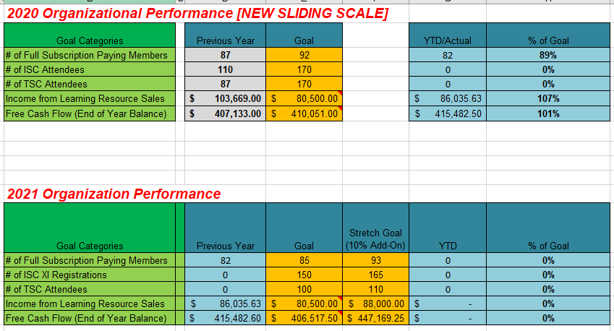

Slide 18
“NEW” Members
Steve Backman – NAPTA Secretary
Presentation of new members
  Universidad de las Fuerzas Armadas ESPE-Carrera de Petroquimica
  Western Service Corporation
  BP (Corporate Membership!)
  Southern University Shreveport – Baton Rouge
  Dale Carnegie

Slide 19
Events/ISC Committee Report
Curtis Briggs
  Industry Co-Chair
  INEOS O&P
Dennis Link
  Education Co-Chair
  College of the Mainland

Slide 20
Endorsement Committee Report
Dorothy Ortego
  Industry Co-chair
  LyondellBasell
Jeff Laube
  Education Co-Chair
  Kenai Peninsula College

Slide 21
Outreach Committee Report
David Hirsch
  Vendor Co-Chair
  Systran
Joseph Zwiercan
  Education Co-Chair
  San Jacinto College

Slide 22
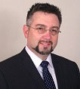
Job Opportunities in the Post-Pandemic Era
Glenn Johnson
Manufacturing Workforce
Development Leader, BASF

Slide 23
On-Going & New Business
Transitions and Challenges
  What is your organization doing to adapt?
  What are your school’s plans for the fall?
  What road blacks are you dealing with?
Online “Best Practice” Sharing
  Do you have something you’ve developed?
  Please share it with ALL at:
  support@naptaonline.org

Slide 24

Stay Safe and Stay Well!

