Slide 1





Improving Performance
Through Training/Education
Dennis Link
2018
“Learning is directly proportional to the amount of fun you’re having.” Bob Pike

Slide 2
Workshop Agenda
Time | Topic
10 Minutes | Workshop Expectations and Objectives
20 Minutes | Training vs. Performance
10 Minutes | Bloom’s Taxonomy
15 Minutes | Training to Performance Steps
15 Minutes | Learning Cone Training Tools
10 Minutes | Review Workshop Objectives, Share Key Learnings and Complete Evaluations
2

Slide 3
Workshop Learning Objectives
At the end of this workshop, you will be able to:
Explain the relationship between training and performance.
Describe application of Bloom’s Taxonomy hierarchy in improving job performance.
Identify the learning and performance impact of various types of training tools in the cone of learning.
3

Slide 4

Workshop Expectations
Use your learning journal to:
Write down at least one thing you’d like to learn during this workshop
Share what you’d like to learn with another participant
4

Slide 5

Initial Personal Expectation Ratings
1
4
7
Low
High
How valuable do you feel this workshop will be to you?
How participative do you plan to be during this workshop?
5

Slide 6
Power of Attitude
“Ability is what you’re capable of doing, Motivation determines what you do and ATTITUDE determines how well you do it.”
Lou Holtz
6

Slide 7
Training vs. Performance
What is the relationship between training and performance?
What is your best tip for training and developing others to be the best they can be?
What motivates you to do a good job as a trainer/educator?
7

Slide 8
Learning Hierarchy
Bloom’s Taxonomy (Cognitive Domain)
Evaluation
Redesign
Optimize
Problem Solve
Apply, Predict
Correlate
Recognize
Synthesis
Analysis
Application
Comprehension
Knowledge
8

Slide 9
Learning Hierarchy
Performance
Redesign
Critical Thinking -Proactive
Optimize
Problem Solve
Task Based -Reactive
Apply
Correlate
Recognize
9

Slide 10
Best Instructor/Trainer
What are the characteristics of your best instructor or trainer
How did your best instructor or trainer impact your learning and development?
How did this experience impact your overall performance and career progression?
10

Slide 11
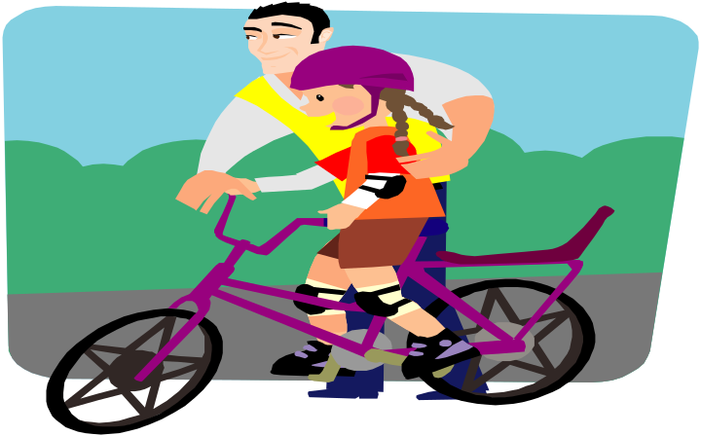
Training to Performance Steps
      Explain WHY it’s important to perform task
      Explain how to perform task
      Demonstrate how to perform task
      Have trainee tell you how to perform the task
      Have trainee demonstrate how to perform task
11

Slide 12
The Learning Cone Exercise
How much we tend to remember?
Doing the Real Experience
Simulating the Real Experience
Doing a Formal Presentation
Write in the % learners tend to remember beside each section of the Learning Cone.
Giving a Talk
Participating in a Discussion
Seeing it Done
Watching a Demonstration
Looking at a Diagram
Watching a Movie
Pictures
Hearing
Reading
12

Slide 13
The Learning Cone
How much we tend to remember?
Doing the Real Experience
Simulating the Real Experience
Doing a Formal Presentation
90% of
what we
Say and Do
Giving a Talk
Participating in a Discussion
70% of what
we Say
Seeing it Done
Watching a Demonstration
Looking at a Diagram
Watching a Movie
50% of what
we Hear and See
Pictures
30% of what
we See
20% of what
we Hear
Hearing
Reading
10% of what
we Read
13

Slide 14
The Transfer of Training
What is WII-FM?
What’s in it For Me!
WII-FM
14

Slide 15
Effective Instructional Delivery
Step 1: State the Lesson Title
Step 2: State the Lesson Objectives
Step 3: Introduce the Lesson
Step 4: Assign Reading and Interactive Exercises
Step 5: Present the Lesson
Step 6: Complete Participative Exercises
Step 7: Summarize the Lesson
Tell them what you’re going to tell them, tell them, then tell them what you told them.
15

Slide 16
Key Messages
Use the knowledge, tips and learnings from this workshop to improve your competence and confidence as a Trainer.
Use a variety of teaching methods to facilitate a participative, fun learning environment.
Continuously improve your training events through feedback process.
Be a change agent difference maker 24/7/52!

Slide 17
Workshop Learning Objectives
At the end of this workshop, you will be able to:
Explain the relationship between training and performance.
Describe application of Bloom’s Taxonomy hierarchy in improving job performance.
Identify the learning and performance impact of various types of training tools in the cone of learning.
17

Slide 18


Workshop Action Plan
Use your learning journal to:
Write down one thing you learned during this workshop
Write down one thing you will do differently as a result of participating in this workshop
Write down one thing you will share with another person
18

Slide 19
ATTITUDE
by Chuck Swindoll
"The longer I live, the more I realize the impact of attitude on life. Attitude, to me is more important than facts. It is more important than the past, than education, than money, than circumstances, than failures, than successes, than what other people think or say or do. It is more important than appearance, giftedness or skill. It will make or break a company ... a church... a home. The remarkable thing is we have a choice every day regarding the attitude we will embrace for that day. We cannot change the past... we cannot change the fact that people will act in a certain way. We cannot change the inevitable. The only thing we can do is play on the one string we have, and that is our attitude.... I am convinced that life is 10% what happens to me and 90% how I react to it. And so it is with you.... we are in charge of our attitudes."
Wish you continued success in the future
and let us all watch our attitudes....
They make a difference in what kind of experience we have everyday.
19

Slide 20

Final Personal Expectation Ratings
1
4
7
Low
High
How valuable do you feel this workshop was to you?
How participative were you during this workshop?
20

Slide 21

Final Thoughts
Thank you so much for your participation and creating a great learning environment. Please use the information and learnings to make a positive difference for you, your work team and your organization.
21

