Slide 1



“Technical Training Skills for Industry and Education”
Instructor Skills Conference XI Update
NAPTA Summer Meeting
July 16, 2021
Curtis Briggs
Dennis Link

Slide 2
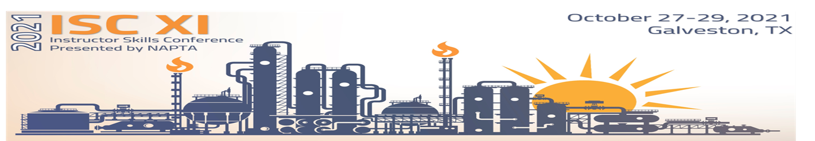
Active ISC XI Committee Members
      Curtis Briggs – Industry Co-Chair
      Dennis Link – Education Co-Chair
      Eric Newby – NAPTA
      Kay Sanchez – NAPTA
      Steve Backman – NAPTA BoD Rep
      Steve Ames
      Myra Fanning
      David Hirsch
      Tim Judge
      Mike Kukuk
      Jeff Laube
      Crystal Lovelady-Jackson
      Sarah Grace Mitchell
      Vicki Newby

Slide 3
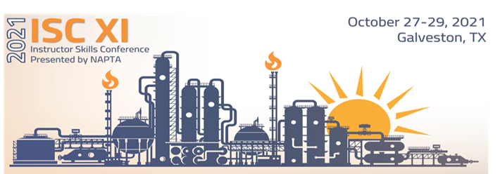
ISC Committee
Vision and Mission
      Vision
      To provide North American Process Technology Alliance (NAPTA) members with value-added, timely and relevant Instructor Skills Conferences that fulfill member and participant needs.
Mission
It is the mission of the Instructor Skills Conference Committee to plan, prepare and execute Instructor Skills Conferences that provide value to attendees.

Slide 4
ISC Committee
Vision and Mission
      Objectives
Using the established Instructor Skills Conference (ISC) Planning Guide, execute successful ISCs that meet the needs of NAPTA membership and prospective members
Recruit NAPTA membership and prospective members to assist in delivering quality ISC content, including:
  workshop presentations
  discussion groups
  speakers
  professional development
  other improvement opportunities
Manage the cost of the ISCs to align with the budget approved by the NAPTA Board of Directors
Work to increase attendance at NAPTA ISCs each year by continuously improving the value of the experience for the participants/attendees
Collaborate with the NAPTA Board of Directors and the other Standing Committees to maximize the impact of the Instructor Skills Committee efforts
Periodically re-evaluate the expansion of NAPTA ISCs by delivering conferences in venues outside the Gulf Coast, as directed/approved by NAPTA Board of Directors
Review and update the Instructor Skills Conference (ISC) Planning Guide annually (post-conference)

Slide 5
Conference Enhancements
      Two Networking Hospitalities: NAPTA 25th Anniversary Oct 27 and Lifetime Achievement Award Oct 28
      Day 1 Break-out Learning Sessions
      New Trainers and Instructors Certificate Track
      Process Technology Core Courses Sharing Best Practices Certificate Track
      Re-institute Discussion Groups and Panel Discussions
      Participant-Decided Learning Sessions Activity
      Networking Treasure Hunt
      Topic of the Day Sharing Opportunity

Slide 6
Keynote Speaker Preview
      Franklin Covey’s Top-Rated Speaker Darin Hoggan, “Leading in the Classroom”
      OSHA’s Houston Area Director, Mark Briggs To Be Confirmed, “PSM Industry and Education Best Practices”
      College of the Mainland Process Technology Graduate Success Story, Marathon Operator and Texas City Mayor Dedrick Johnson

Slide 7
Learning Sessions Preview
      Seven Habits of Highly Effective Trainers and Instructors led by Franklin Covey’s Darin Hoggan
      PSM Training and Education Discussion Group led by OSHA’s Houston Area PSM reps
      How to Present Complex Concepts to Diverse Audiences by Dale Carnegie CEO and President Dave Wright
      Virtual Process Troubleshooting “Hands-on” Workshop
      Creating Valid Test Questions
      Augmented Virtual Reality Learning Techniques
      Bias Awareness
      Championing Diversity
      New Hire Job Qualification Process
      Simulator Best Practices Panel Discussion
      Process Technology Exit Exam – Chemical / Refining (PTEX-CR) Discussion Group

Slide 8
NAPTA Member Action Plan: Goal of 200+ Attendees
  Share ISC XI updates with:
      Industry Training Personnel
      College and High School Instructors
      Process Technology Advisory Committee Members
      Training and Education Vendors
  Utilize the following Communication tools to share ISC XI updates:
      LinkedIn
      Facebook
      Twitter
      Company email
      College email
      Face-to-Face Communication

Slide 9
“Technical Training Skills for Industry and Education”
Many successful people attribute their success to a teacher, instructor or trainer that made a positive difference in their life. If you want to be a difference making role model mentor that others will remember for the rest of their lives, then the North American Process Technology Alliance Instructor Skills Conference XI is designed for you.
See you “on the beach” in Galveston October 27-29, 2021!
Exciting News: We’re heading back to the BIG EASY, New Orleans, for ISC XII Fall 2022!!

