Slide 1

Endorsement Committee
July 2021 Report

Slide 2
Active Endorsement Committee Members
Dorothy Ortego – Industry Co-Chair
Jeffrey Laube – Education Co-Chair
Linda LaCoe
David Carty
Bob Ash
George Bohn
Steve Duff
Alisha Nash NAPTA BoD
Mike Lopez NAPTA BoD Rep

Slide 3
Endorsement Committee
Vision and Mission
Vision
To provide North American Process Technology Alliance (NAPTA) member colleges with comprehensive program audits designed to help member colleges improve their process technology program.
Mission
It is the mission of the Endorsement Committee to perform program audits to help colleges improve their process technology program.

Slide 4
2021-22 Endorsement Committee Goals
Task
Continue auditing schools for endorsement and re-endorsement
Revise the endorsement requirements as needed and update the webpage to match those requirements.
Recruit additional endorsement committee auditors
Set a defined timeframe for college responsibility for endorsement
Evaluate industry interactions with the schools versus the requirement of advisory committee

Slide 5
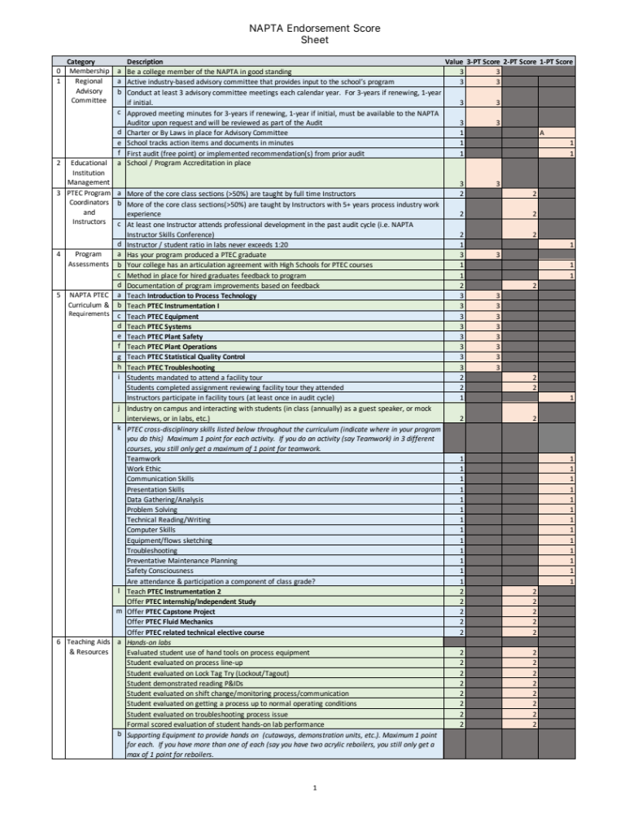
NAPTA Endorsement Score Sheet
3-pages long
College to self score
3-point items are required
  78 Points Required
2 & 1 point items are suggested
  216 total possible points
A total score of 147 or higher to be endorsed

Slide 6
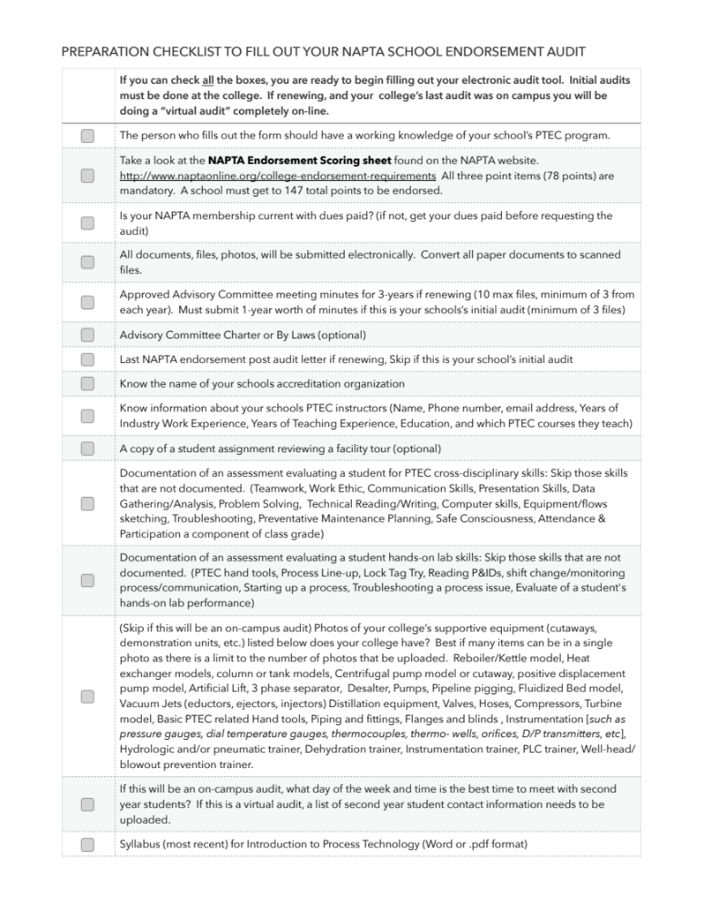
NAPTA Endorsement Check List
UPDATED JUNE 2021
2-pages long
Helps college to know the documents to collect to successfully submit an audit
New version on the NAPTA website

Slide 7
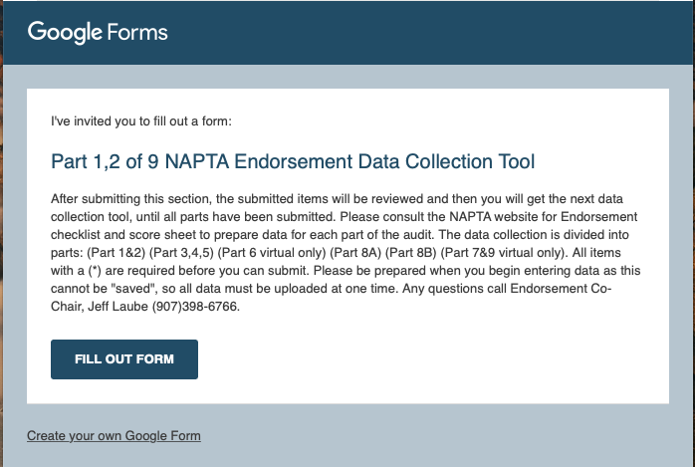
NAPTA Virtual Audit Tool
Once your ready, you will receive an email to fill out the audit tool form

Slide 8
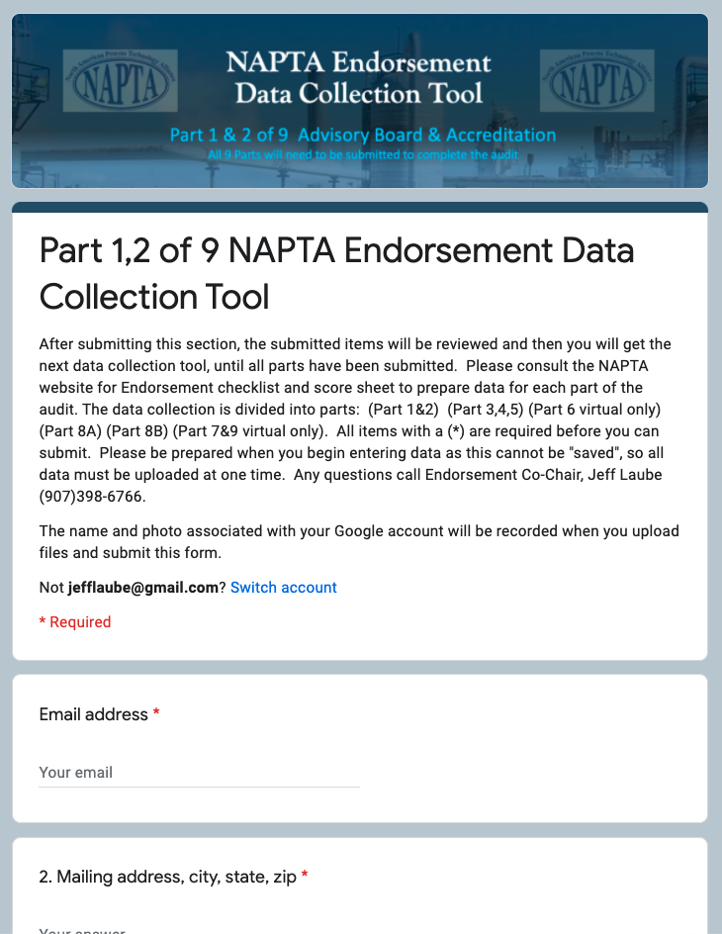
NAPTA Virtual Audit Tool
Completely online
Six parts
About 65 questions total
College to submit all documents
Be prepared to submit all audit documentation for each section in one sitting

Slide 9
Colleges interested in an initial endorsement audit or re-endorsement
If you are wondering if your college meets the endorsement requirements, get the score sheet off the NAPTA website and self audit your program

Slide 10
Colleges Currently Fully Endorsed
Brazosport College | 2022
Lewis & Clark Community College | 2022
Mississippi Gulf Coast Community College | 2022
Wharton County Junior College | 2022
Kenai Peninsula College | 2023
Lamar Institute of Technology | 2023
Alvin Community College | 2024
Houston Community College | 2024

Slide 11
Colleges that have been endorsed but need to be re-endorsed by October 2021
Nunez Community College
Baton Rouge Community College
COM
Del Mar College
ITI Technical College
Kilgore
Lamar State College — Orange
Lamar State College — Port Arther
Lone Star College
Louisiana Delta Community College
Remington College - Houston
River Parishes Community College - Gonzales
River Parishes Community College - Reserve
San Jacinto College - Central
South Arkansas Commuity College
Sowela Technical Community College
Texas State Technical College
University of Alaska Fairbanks

Slide 12
Associate Colleges
Bellingham Technical College
Bishop State Community College
Bismarck State College
Bossier Parish Community College
Calhoun Community College
Community College of Allegheny County
Community College of Beaver County
Delaware Technical Community College
Henry Ford College
Kankakee Community College
Lincoln Trail College
Los Medanos College
Middlesex County College
Northern Oklahoma College
Universidand de las Fuerzas Armadas ESPE-Carrera de Petroquimica
University of South Alabama
Victoria College
Associate Colleges are welcome to start the endorsement process.

Slide 13
If your college is planning an endorsement audit
Get the score sheet off the NAPTA web site
Get the check list off the NAPTA web site
Collect your documents (Speak to all faculty about saving documentation)
Once you have all the documents collected → Email NAPTA to get the audit document collection tool

Slide 14
A great way to be an endorsed school is to join the Endorsement Committee
To be an endorsement auditor: you will be trained and shadow two audits.

