Slide 1
Thanks for Joining Us!
The NAPTA 2021 Winter General Meeting will start in a few minutes!
The Audio, Video, Participants, and Chat buttons are across the bottom of your screen and will appear as you move your cursor
Please stand by and have your audio muted unless you need to speak

Slide 2

WELCOME TO THE WEB!
Winter Virtual Meeting
VIA MS Teams
Friday, February 26, 2021

Slide 3
Welcome to the NAPTA General Meeting
Greetings from the NAPTA
Board Vice-Chair
Alisha Nash
Safety Moment
“caring by sharing”

Slide 4
NAPTA Board of Directors
2021 Board of Director Members Are:
Scott Krejci – Chair/Chief Executive Officer (interim)
Alisha Nash – Vice-Chair
Glenn Johnson – Treasurer/Chief Financial Officer
Eric Newby – President/Executive Director
Steve Backman – Secretary
Madonna Adams – Director
Sallie Kay Janes – Director
David Esquibel – Director

Slide 5
NAPTA Committee Leadership Team
2020/21 Leadership Team Members are:
Curriculum Committee - Martha McKinley
Vacant
Endorsement Committee - Dorothy Ortego
Jeff Laube
Events/ISC Committee Curtis Briggs
Dennis Link
Events/TSC Committee - Vacant & Vacant
Outreach Committee - David Hirsch
Joseph Zwiercan

Slide 6
NAPTA Lifetime Achievement Award
  Mike Kukuk
  Martha McKinley
  Gary Hicks
  Steve Ames
  Bill Raley
  Dorothy Ortego
  Thanks for your service to The Alliance

Slide 7
Curriculum Committee Report
Martha McKinley
  Education Co-Chair
  NAPTA
Kelly Trakalo
  Project PTEC Project Lead
  Pearson Education

Slide 8

NAPTA
Learning
Materials
Update
Winter Meeting
February 21, 2020

Slide 9




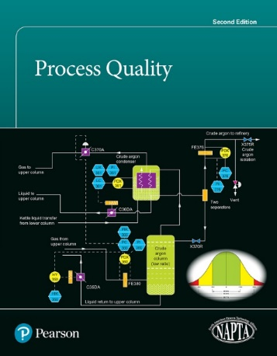
Available Now!
Introduction to Process Technology, 2e
Process Technology Equipment, 2e
Safety, Health and Equipment, 2e
Process Instrumentation, 2e
Process Quality, 2e

Slide 10
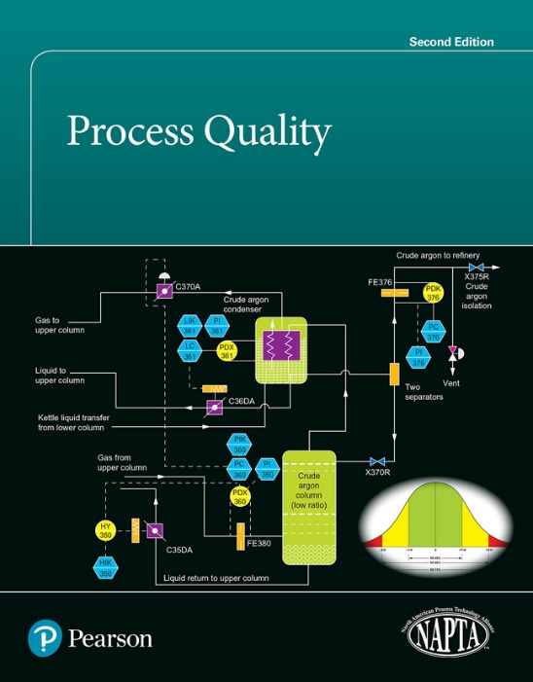
What’s New in Process Quality, 2e?
Content reorganization to enhance learning: content flows from basic Quality concepts (Part 1) to major Quality strategies (Part 2) to Quality Tools (Part 3) to Application of Control Charts (Part 4).
Learning Outcome alignment with NAPTA core objectives, with links provided from objective to text page.
New series design and features
New! Comprehensive art program including more than 350 full-color images.
New Chapter on data collection and representative sampling
• New content on economics, soft skills and “Teams”
• NEW Instructor Resource Package
Also Available as a Stand Alone eText

Slide 11

In Development - Coming
Process Operations, 2e
Process Systems, 1e
First draft chapters in development and review
Coming 2021

Slide 12
Image by Nathalie Lees
Instructor Resources
(available for download on instructor resource center)
Instructor resource | Description
Lesson plans | For each chapter: Suggested teaching time to reach objectives Any particular prep needed Suggested classroom and lab activities Set of unique MC review questions similar to but unique from EOC questions
PPT slides | Chapter by chapter and associated with lessons in lesson plans
Review questions | End of lessons (and/or chapter) review questions
Test bank | 3-5 multiple choice questions per chapter objective, tagged to learning objectives. Include correct answer and rationales for all answers.

Slide 13

MyLab Process Technology
Available for the following:
Introduction to Process Technology, 2e
Process Technology Equipment, 2e
Safety, Health, and Environment, 2e
Process Instrumentation, 2e
Includes:
Key Term Review (interactive)
Chapter Review Quiz Questions
Equipment and Process Review (interactive)
Short Answer Questions
Pearson eText
All instructor resources

Slide 14
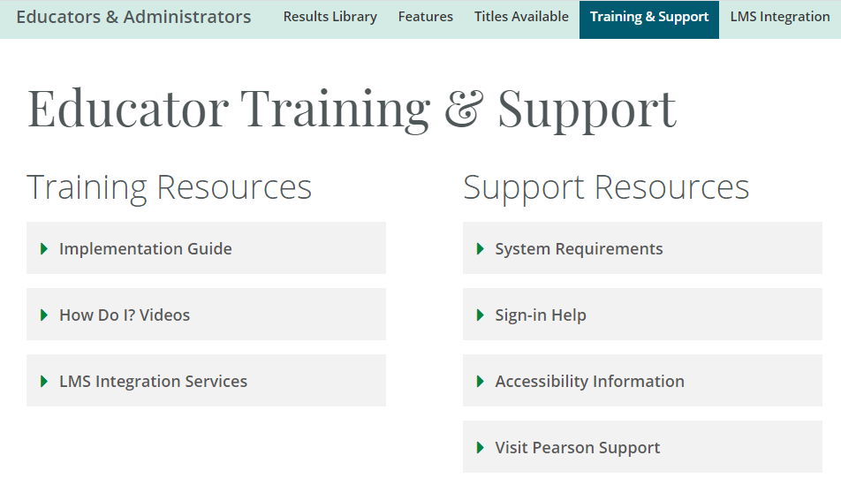
Additional MyLab/Process Technology Resources

Slide 15
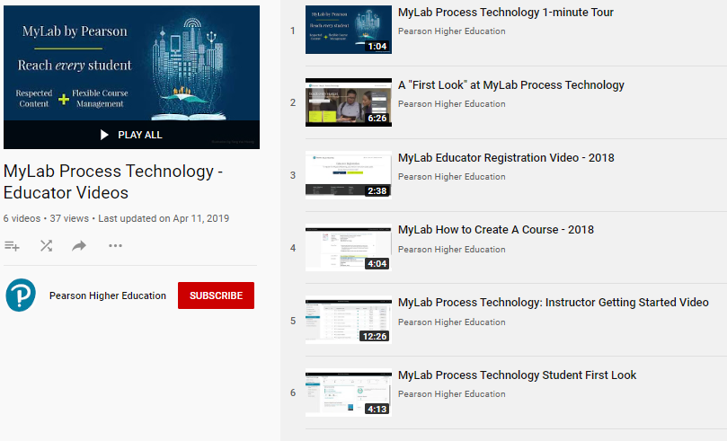


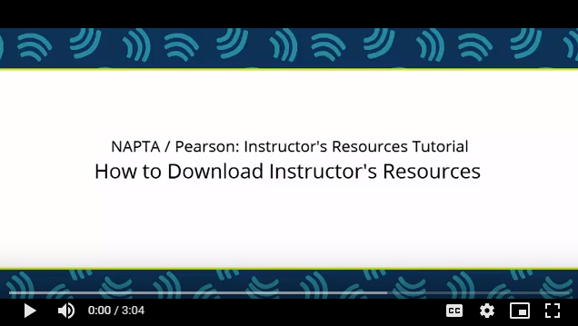
Additional MyLab/Process Technology Resources
Educator
Videos
Student
User’s
Guide
Instructor
Implementation
Guide
Instructor
Resources
Video

Slide 16
Questions?

Slide 17
TSC Committee Report
Martha McKinley
  TSC Event Coordinator
Eric Newby
  Interim Co-Chair

Slide 18
NAPTA Financial Report
Glenn Johnson
  Treasurer/Chief Financial Officer
  Head of Workforce Development
  BASF North America

Slide 25
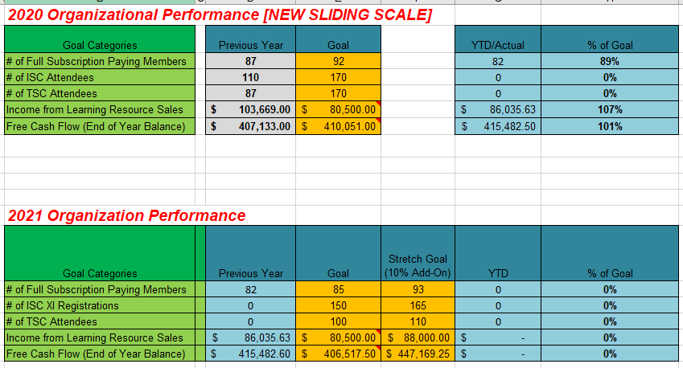

Slide 27
“NEW” Members
Steve Backman – NAPTA Secretary
Presentation of new members
University of South Alabama
Mobile, AL
Steven Duff – Program Chair

Slide 28
Events/ISC Committee Report
Curtis Briggs
  Industry Co-Chair
  INEOS O&P
Dennis Link
  Education Co-Chair
  College of the Mainland

Slide 29
Events/ISC Committee Members
Curtis Briggs (Co-chair)
Dennis Link (Co-chair)
Steve Ames
Steve Backman
Myra Fanning
Tim Judge
Mike Kukuk
Jeff Laube
Sarah Grace Mitchell
Vicki Newby

Slide 30
ISC XI Update
Planning a face-to-face conference for 2021.
When: October 27-29 (Wednesday – Friday).
Where: Galveston Island Convention Center/Hilton Hotel.
Updates for ISC XI:
  Revamp Learning Sessions
  Panel discussion and workshop offered on day 1
  Improved LAA presentation
  Multiple keynote speakers

Slide 31

ISC XI Banner

Slide 32
ISC XI Promotional Video

Slide 33
Endorsement Committee Report
Dorothy Ortego
  Industry Co-chair
  Sasol/US
Jeff Laube
  Education Co-Chair
  Kenai Peninsula College

Slide 34
Outreach Committee Report
David Hirsch
  Industry/Vendor Co-Chair
  Systran Inc.
Joseph Zwiercan
  Education Co-Chair
  San Jacinto College

Slide 35
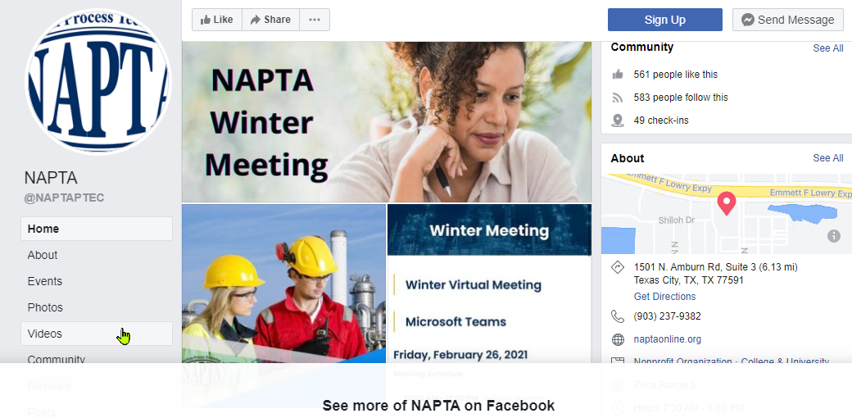
Outreach Committee Report

Slide 36
On-Going & New Business
Transitions and Challenges
  What is your organization doing to adapt?
  What are your school’s plans for the fall?
  What road blacks are you dealing with?
Online “Best Practice” Sharing
  Do you have something you’ve developed?
  Please share it with ALL at:
  support@naptaonline.org

Slide 37
On-Going & New Business
Open Forum Discussions
What’s on your mind?
Any Questions?

Slide 38

Stay Safe and Stay Well!

