Slide 1

Operations Center Shift Change Exercise
September 26th & 27th, 2018
Donald Glaser, Simulation Solutions, Inc.
Matt Garvey, Simulation, Solutions, Inc.

Slide 2
Ops Center Shift Change Team Exercise
Abstract
Session Outcomes
Conduct an extensive role play exercise involving actual PTEC Students showing PTEC Instructors and Plant Training Departments how to facilitate and deliver team exercises that promote a variety of operations, shift change, troubleshooting, critical thinking, communications, cooperation, leadership, and team building skills.
Help Instructors to develop and deliver role play exercises that help to develop "team" skills.

Slide 3
Workshop Schedule
Shift Change Case Studies and Justification
Introduction to Shift Change Exercise
Shift Change Exercise Roleplay
Shift Change Exercise Recap – Instructor Tips

Slide 4
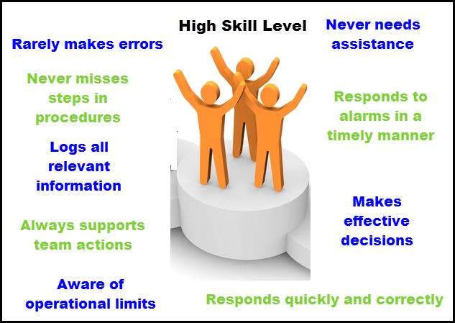
Goal – All Round Operator

Slide 5







Operations Jobs are Complex
Console Operation
Communication
Decision Taking
Co-operation
Procedural Adherence
Situational Awareness
Leadership

Slide 6

ADNOC Case Study:
Training Operators in Isolation
“Most plants have dynamic Simulators. These simulators are for training and testing of a Control Room Operator in isolation.”
Training by dynamic simulators does not cover behavioral and interpersonal skills such as communication between Control Room Operators, leadership, coaching, teamwork, assertiveness, etc…
Developing the Competency of Graduates in Plant Operations, Joop Verkoelen, ADNOC 2007 ©

Slide 7
Using Operator Training Simulators to Strengthen “Soft Skills”
Simulators are traditionally used to test technical abilities such as troubleshooting or ability to operator common plant equipment.
Dynamic Exercises such as a shift turnover exercise allows students to practice “soft skills” while using a dynamic tool.
These “soft skills” include:
  Communication
  Leadership
  Adaptability

Slide 8
Plant Operations Team Roles – Understanding the Complexity of an Operations Team
Console Operator: Responsible for controlling the process via the DCS, monitors and controls plant, responsible for coordinating the actions of field operators, keeping abreast of the maintenance activities in the field
Field Operator: Responsible for his/her own plant area, often qualified for other areas as well. Supports maintenance activities in the field, serves as a human sensor, who checks or validates the correctness of sensors, to ensure the view of the process is accurate. They are the first “on the scene” and provide critical diagnosis.
Shift Leader: Responsible for overseeing the field and console operator in the detailed monitoring of the process.
Operations Superintendent: Responsible for productive and safe operations of the complex. (complex is typically run by multiple shift teams).
Shift Coordinator: Plays the role of operation teams coordinator and management interface between operations superintendent and operations staff.
Site Planner: Responsible for tracking possible market opportunities (e.g. high demands, high price, schedule shipments, weather conditions) that may arise along with planning maintenance/turnarounds.
Process Engineer: Responsible for generating daily production orders for each process unit (developed by site planner), troubleshoots process unit problems.
Control Engineer: Maintains control tuning, develops improved control, often troubleshoots process & control related problems after operations have been stabilized by operators.
Maintenance Coordinator: Responsible for coordination of maintenance activities for plant units, coordinates periodic preventive maintenance and requests put in by operations team, orders material, determines whether contractors need to be hired.
Maintenance Technician: Responsible for maintain and repairing all process equipment.

Slide 9
Levels of Involvement in Operations
Adapting to
Maintain
Production Specs
Safety
Operating and Managing
a Team of Personnel
Communication
Operating During Abnormal Situations
Operating Within Normal Conditions (Steady State)

Slide 10
Yokogawa Advanced Solutions
Case Study
Startup, shutdown and changeover (shift change) periods account for less than 5% of operations staff time.
40% of plant incidents occur during these times of abnormal operations
Poorly written notes and/or technical misunderstandings are the root cause to many of these incidents
Shift-Handover: 5% of Operations Time, 40% of Incidents, blog-yokogawa-com.cdn.ampproject.org

Slide 11
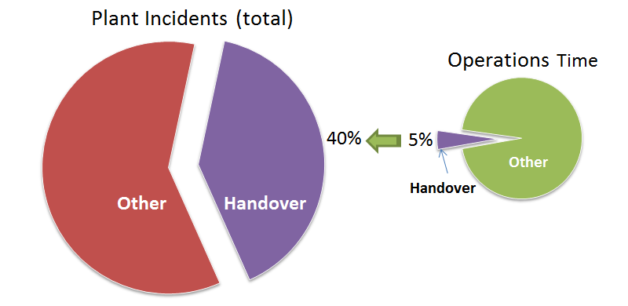
Shift Handover Statistics
NPRA, National Safety Conference and Exhibition ©2009

Slide 12
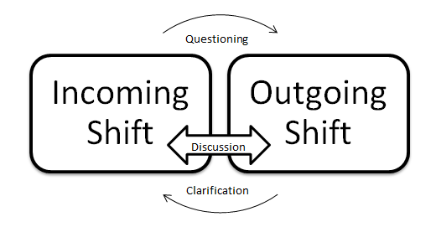
Importance of Verbal Communication
Outgoing operator: Describe the entry
Incoming operator: Ask any and all pertinent questions
Incoming operator: Describe the results he would expect
Outgoing operator: Confirm or Correct expected results
Shift-Handover: 5% of Operations Time, 40% of Incidents, blog-yokogawa-com.cdn.ampproject.org

Slide 13
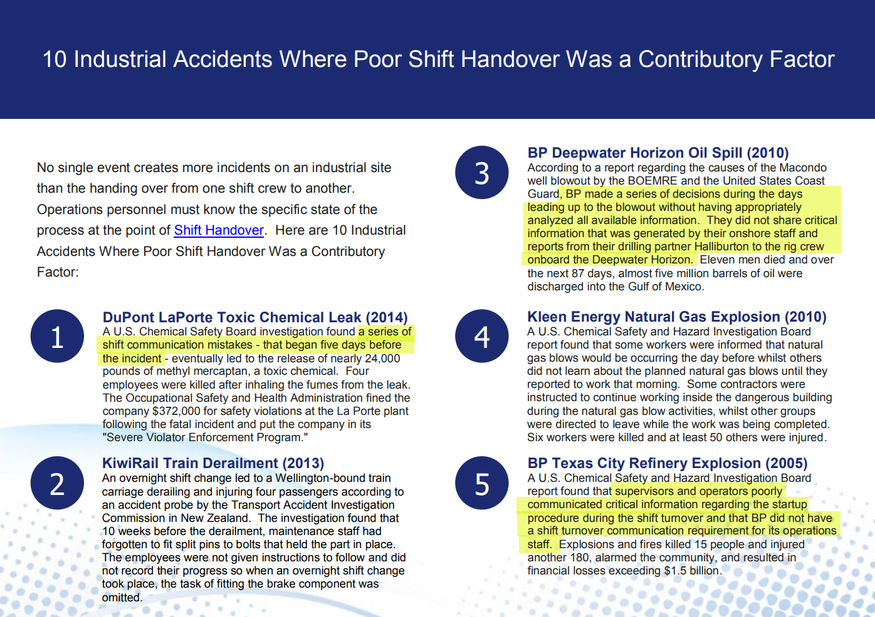
NPRA, National Safety Conference and Exhibition ©2009
J5 International 2017©
J5int.com/wp-content/

Slide 14
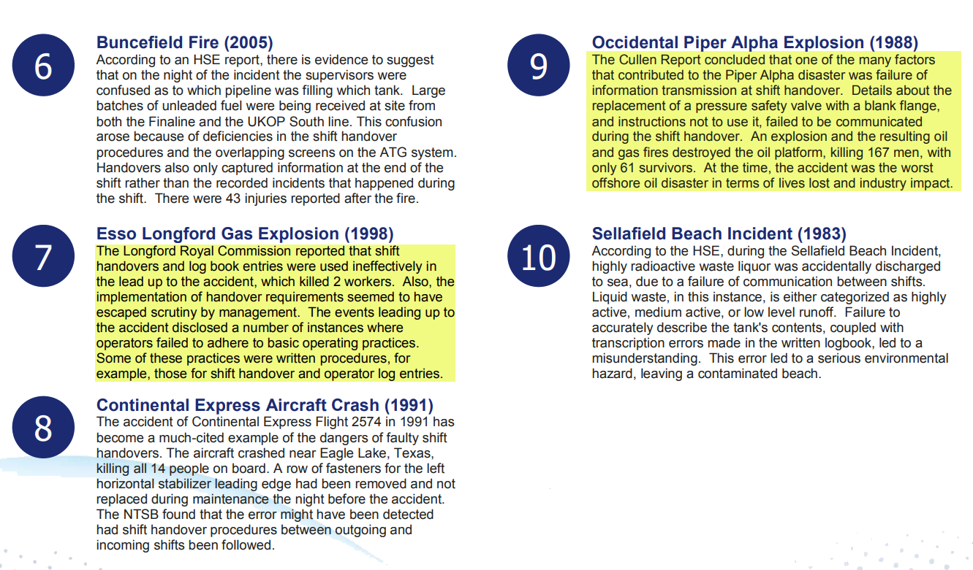
J5 International 2017©
J5int.com/wp-content/

Slide 15

NAPTA
2018
Reference IAEA Safety Standards
Conduct of Operations Safety Guide
No. NS-G-2.14

Slide 16
IAEA Standards: Shift Turnover
Shift Turnover should be carried out in accordance with a formal procedure
The procedure should provide for a clear declaration of acceptance of duty from the incoming operator before the outgoing operator is released
A shift turnover should not take place during critical upsets or abnormal conditions

Slide 17
IAEA Standards: Shift Turnover
Non-routine operating activities should be prohibited in the main control room during shift turnover
Access of non-shift personnel to the main control room during shift hand over should be prohibited or minimized
All important information about the plant status, the work in progress and the plant evolutions in the previous shift should be transferred and documented properly in the course of the shift handover

Slide 18


“Process Safety Education Using Simulators in a Chemical Engineering
Operations Center Experience”
Mr. Donald C. Glaser
President
Mr. Matthew Garvey
Project Engineer
Simulation Solutions, Inc.
179 Avenue at the Common, Suite 1
Shrewsbury, NJ 07702-4804
dgalser@simulation-solutions.com
Robert G. Bozic, Ph.D.
Lieutenant Colonel U.S. Army(Retired)
Lecturer in Chemical Engineering Design and
Chemical Engineering Process Safety
Department of Chemical Engineering
Columbia University in the City of New York
robert.bozic@columbia.edu

Slide 19
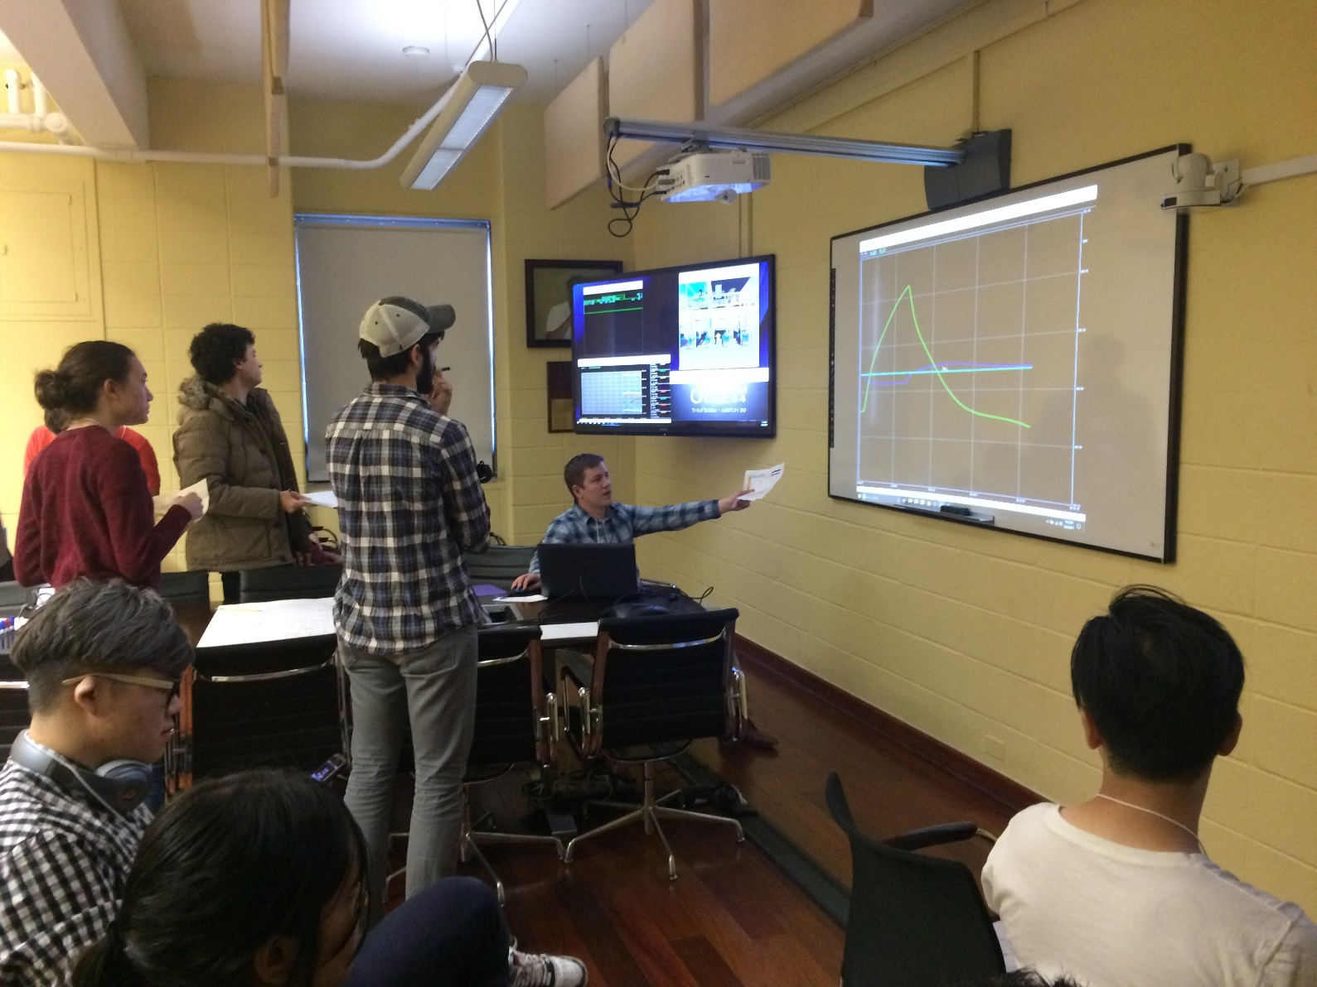
Operation Center Experience
Group 1, Process Engineers talk to the operator about what is appearing on the display screen while some students observe the action. 30 March 2017

Slide 20
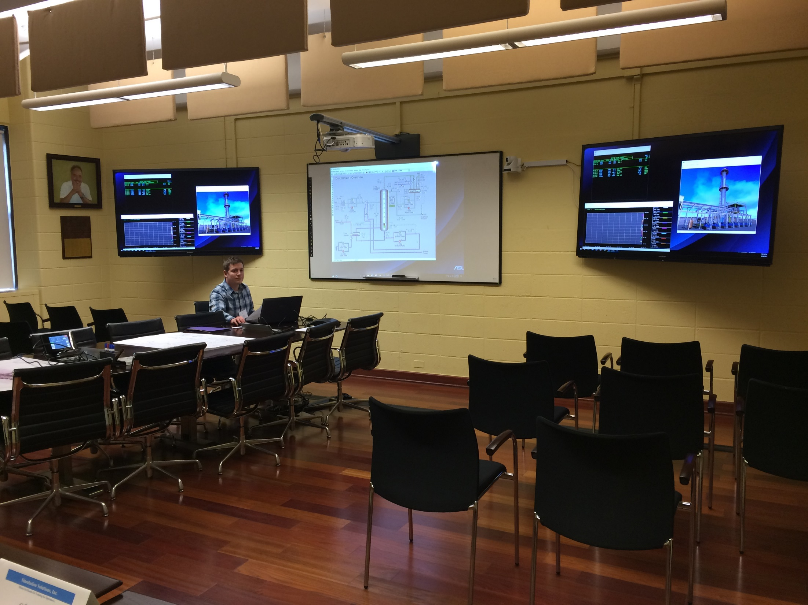

Slide 21
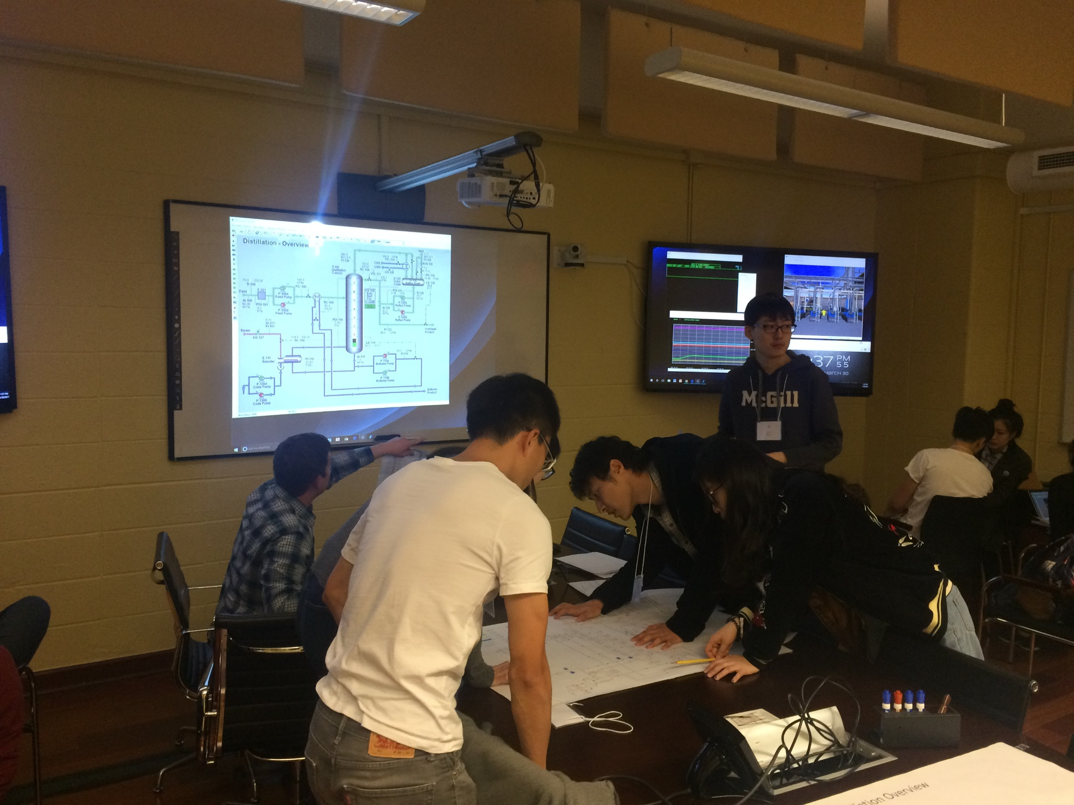

Slide 22
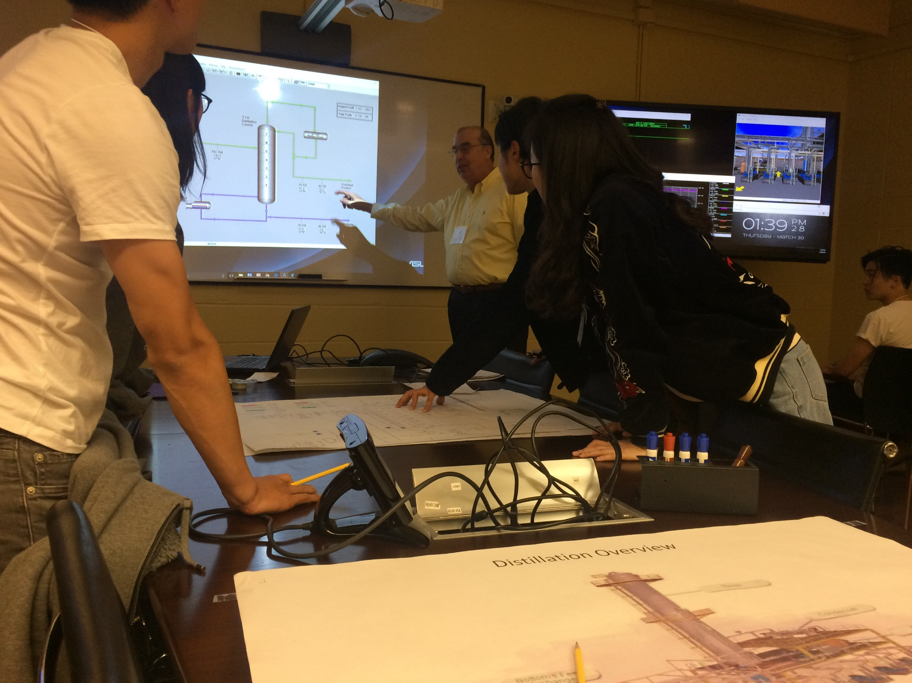

Slide 23

Ops Center Shift Change Team
Exercise Outcomes

Slide 24
Workshop Schedule
Shift Change Case Studies and Justification
Introduction to Shift Change Exercise
Shift Change Exercise Roleplay
Shift Change Exercise Recap – Instructor Tips

Slide 25
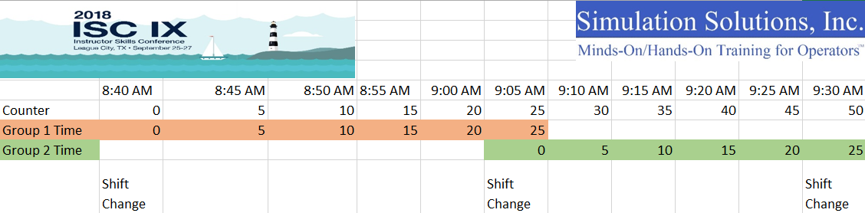
Shift Change Exercise Schedule
Operations teams will be responsible for effective shift turnover and will face plant upsets and interruptions. Production rates will be a focus of the supervisor’s role and the operations teams must fill out all necessary shift change documents.

Slide 26
Shift Change Exercise Roles
Don Glaser, SSI – Operations Supervisor – will ask for reports on the production of products and stress operators if products are off spec
Matt Garvey, SSI – Junior Operator – will handle all “button pushing” of Simulator and will take directives from Ops Team
PTEC Students – Operations Team - will watch the DCS and have access to trends, alarm summaries, and DCS pages. Will direct Matt on how to operate the Simulator
Ngee Ann Polytechnic Staff – Interrupters involving requests for Work Permits, Plant Entry, Role of Outside Operator, etc..
Audience- Observers – will be given a sheet which highlights competencies being tested in this exercise and they can score the Operations Team.

Slide 27
Workshop Schedule
Shift Change Case Studies and Justification
Introduction to Shift Change Exercise
Shift Change Exercise Roleplay
Shift Change Exercise Recap – Instructor Tips

Slide 28
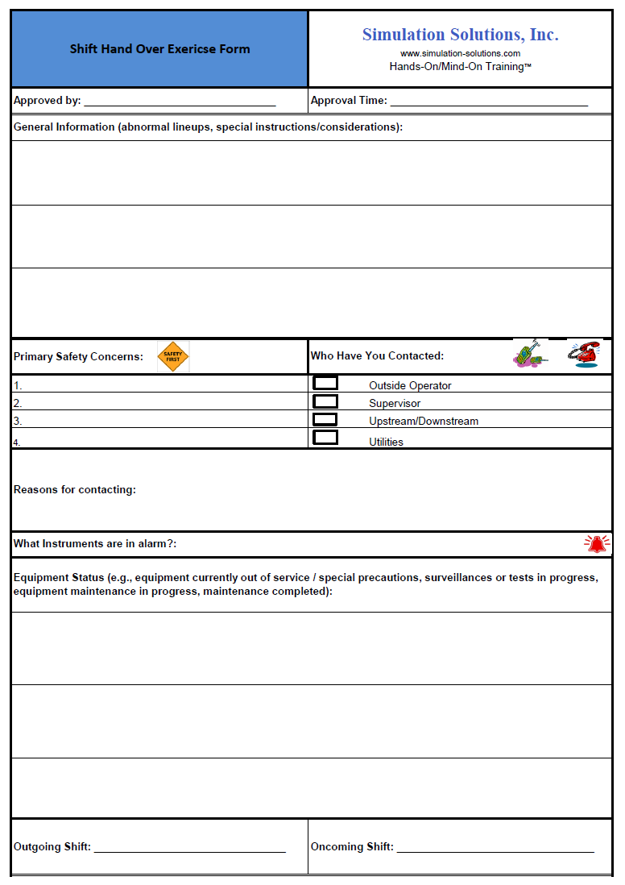
Shift Handover Form Example

Slide 29
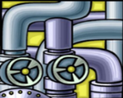






Troubleshooting Think EQ.U.I.P.P.E.D.™
OBSERVATIONS: (PV’s, Trends, Alarms…)
Equipment
Utilities
Instrumentation
Process
Pumps
Steam
Controls
Feed Quality/Temperature
Sensors
Catalyst
Valves
Power
Plant
Upset
Exchangers
Cooling
Water
Regulators
Levels
BVs + Drains
Rain
Tankage
Fatigue
Wind
Back Pressure
Communication
Ambient Temperature
Non-Steady State
People
Environment
Downstream / Upstream

Slide 30
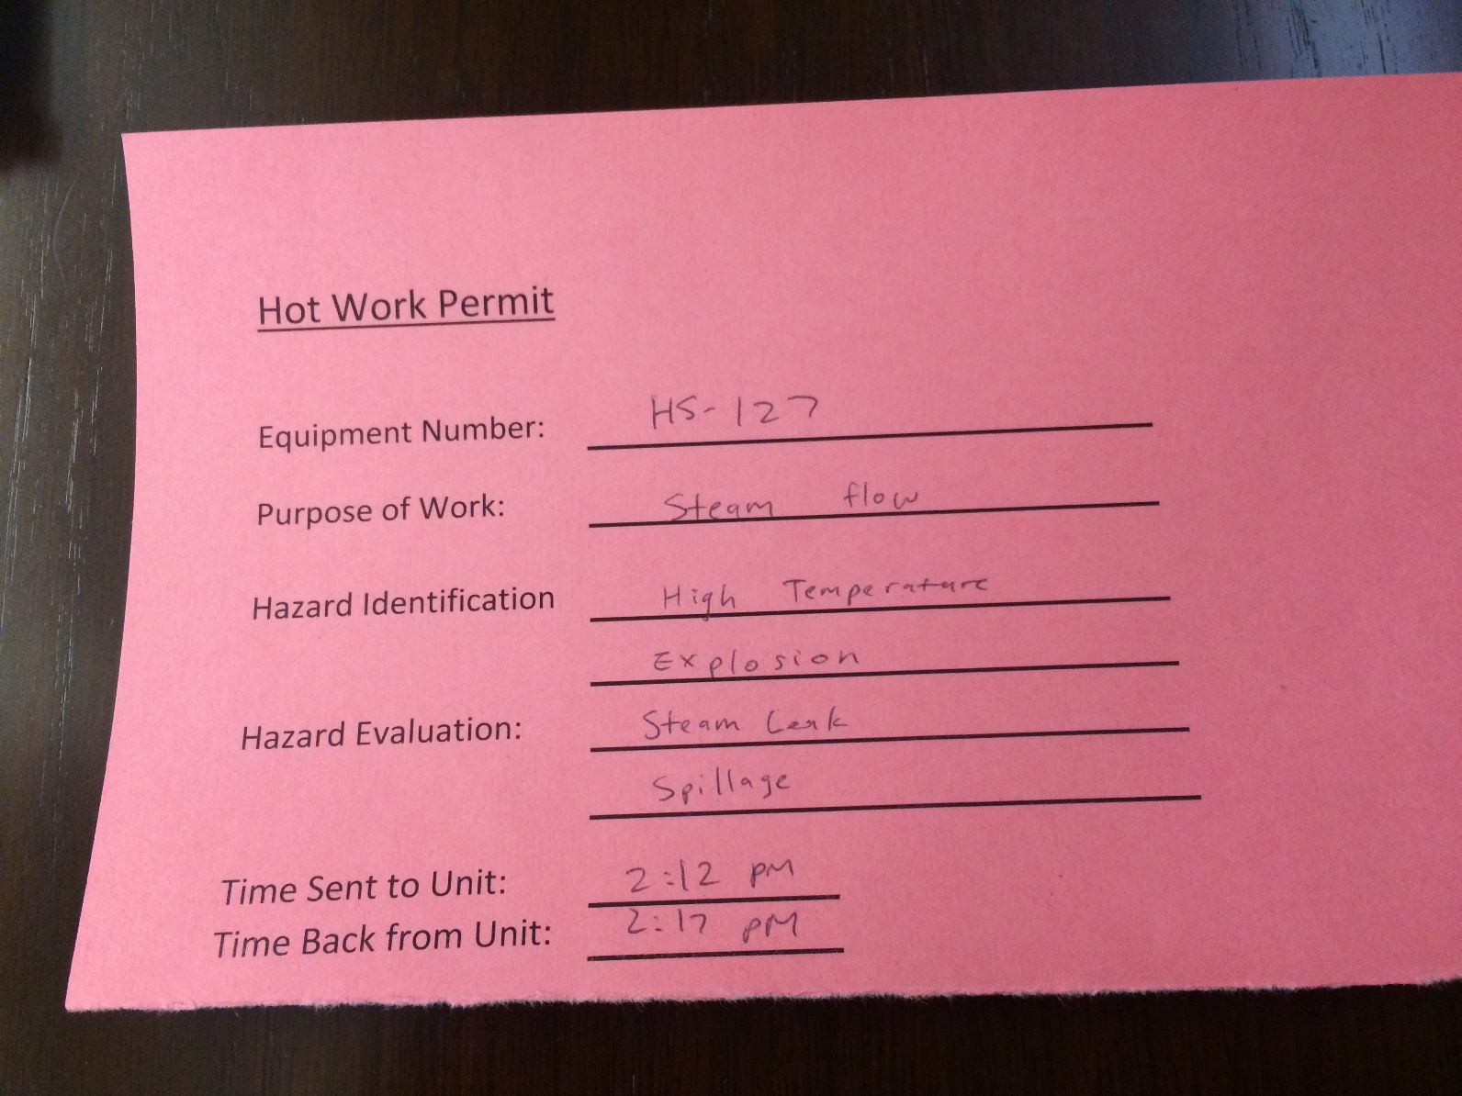
Hot Work Permit Sample

Slide 31
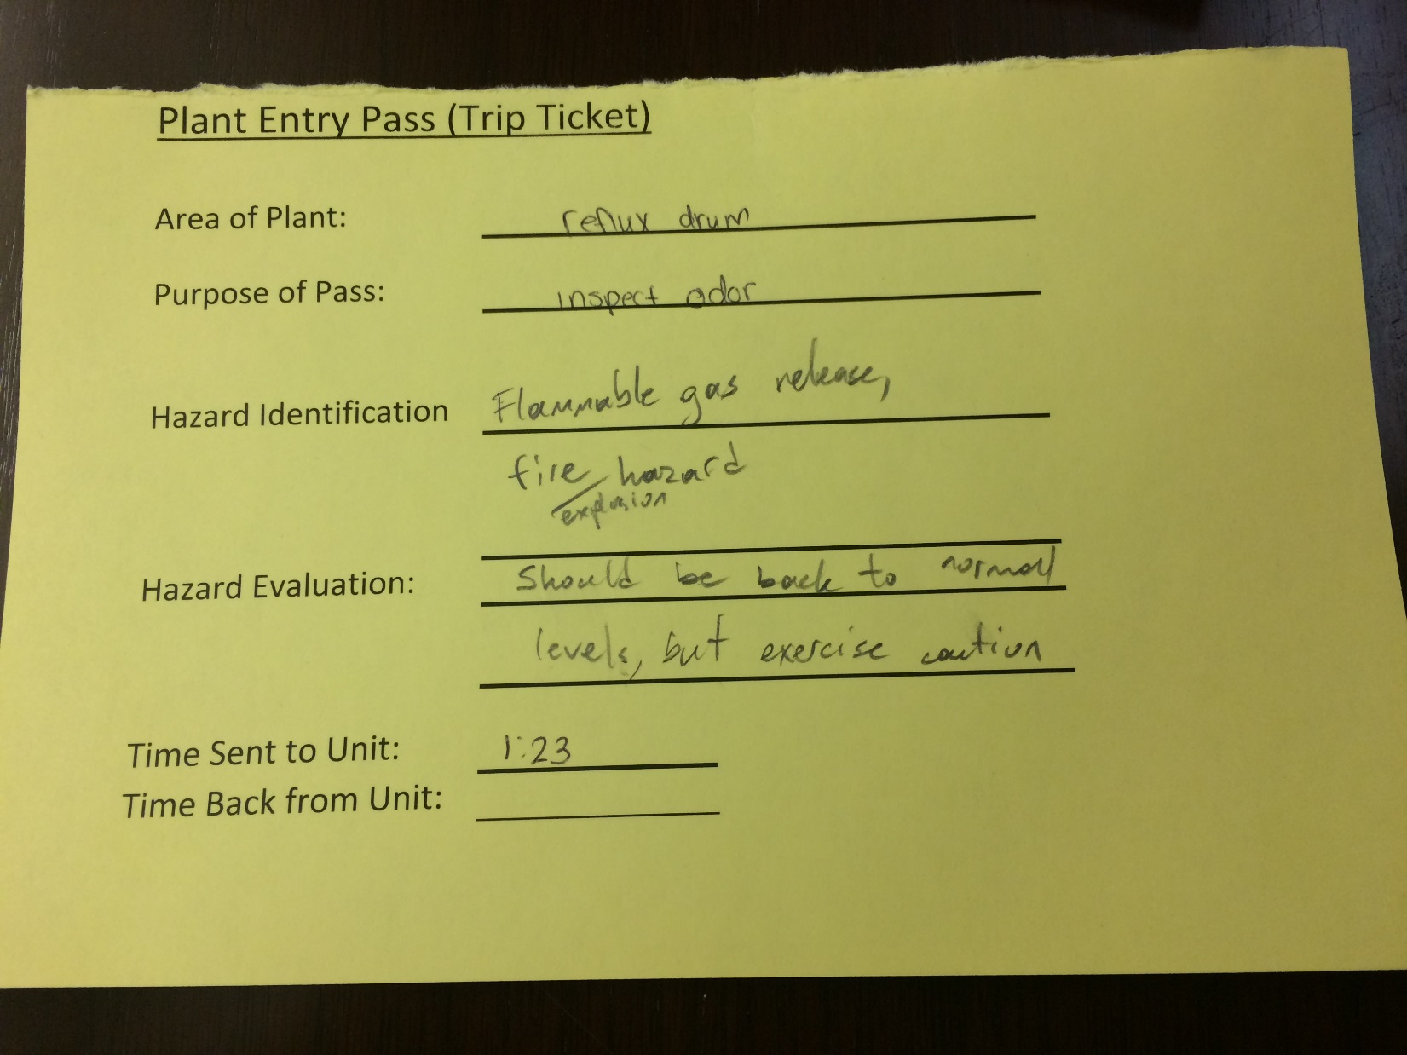
Plant Entry Pass Sample

Slide 32
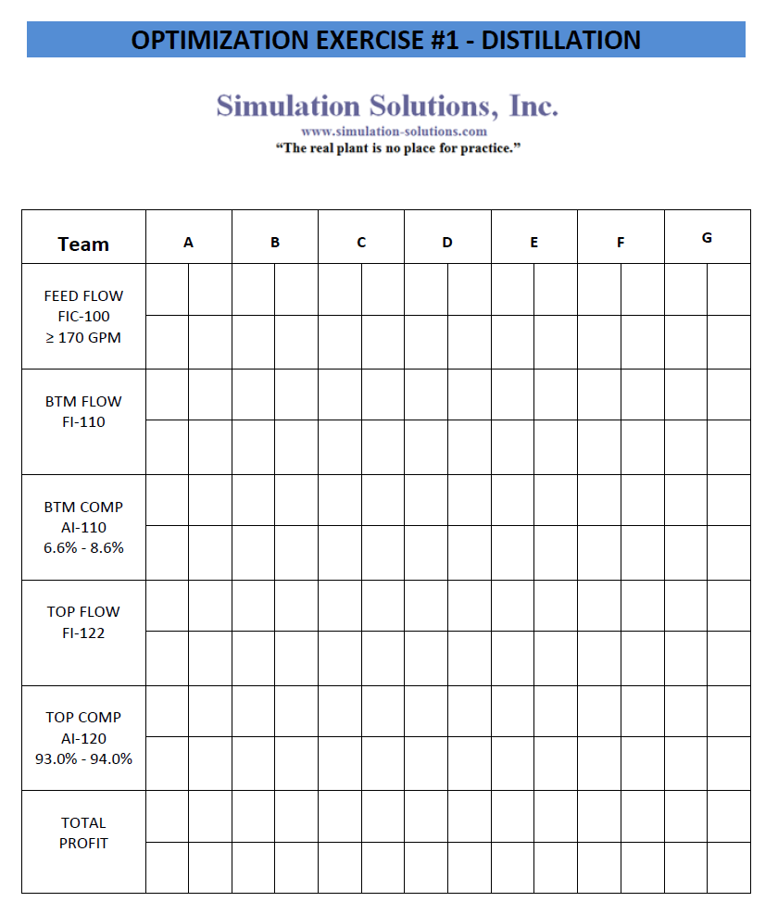
Production Rates / Specs
Recording Sheet (Profitability)

Slide 33
Workshop Schedule
Shift Change Case Studies and Justification
Introduction to Shift Change Exercise
Shift Change Exercise Roleplay
Shift Change Exercise Recap – Instructor Tips

Slide 34
Instructor Tips
Split trainees into groups to play the role of Console Operator or Outside Operator to increase participation
Potential Interruptions
  Work Orders from Contractors
  Plant Entry Pass Needed
  Call from Outside Operator
  Distractions from other Operators, Supervisors, Management, etc
Conduct Exercise during a planned shutdown or startup on Simulator
Students not involved in roleplay are to complete workbook pages making notes of effective and non effective shift turnover strategies.

Slide 35
Audience Feedback
Identify 3 challenges the Operations team faced when confronting malfunctions in the Exercise.
Identify 3 challenges the Operations team faced specifically concerned with Shift Handover.
What are your recommendations for improving performance?

Slide 36
Acknowledgements
A special thank you to Ngee Ann Polytechnic, College of the Mainland and San Jacinto PTEC Department for all of their assistance and support!

Slide 37
Thank you!
Donald C. Glaser dglaser@simulation-solutions.com
Simulation Solutions, Inc.
Shrewsbury, NJ 07702 www.simulation-solutions.com
732-389-5400

